Slide 2
Table of Contents
Lesson 1
Lesson 2
Lesson 3
Lesson 4
Click here to return to previous slide.

Slide 3
Lesson 1
Critical Thinking at Work
Lesson Preview
Using Your Resources
Taking a Pre-Assessment
Understanding Critical Thinking
Breaking Mechanical Thinking
Using Socratic Questions
Managing Emotional Thinking
Using Memory Techniques
Building Understanding

Slide 4
My Goal
To understand the resources that help me think more critically

Slide 5
Using Your Resources
How should I use the resources I have?
Your participant guide contains the practical tools and practice that will help you deepen your thinking. This material is designed to guide you during the session and also back at your desk.

Slide 6
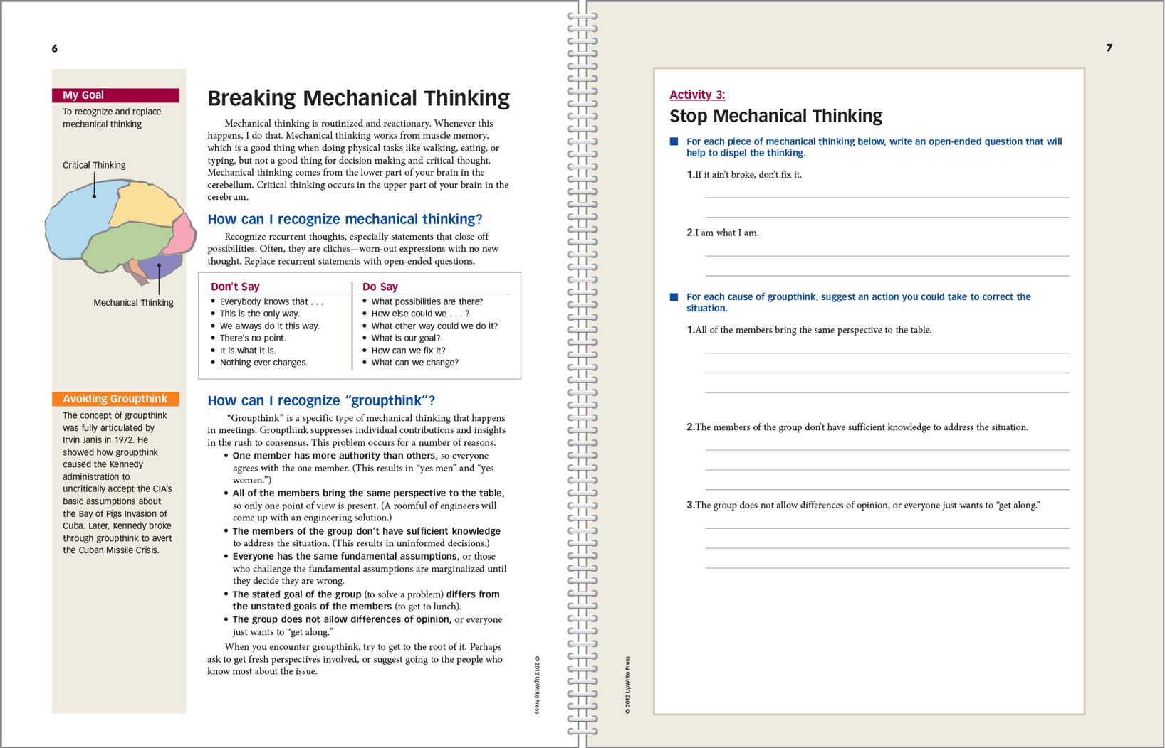
Using Your Resources
Left-hand pages contain instructions and examples.
Right-hand pages contain activities.

Slide 7
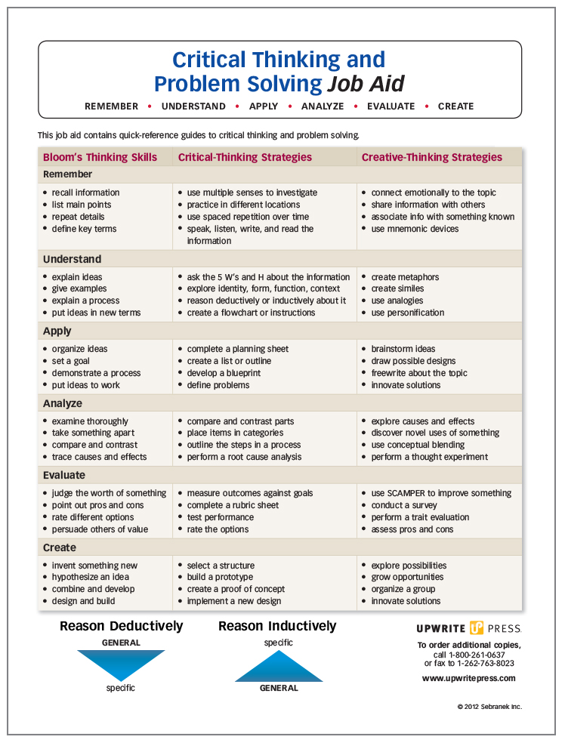
Using Your Resources
The Job Aid puts critical-thinking strategies at your fingertips.

Slide 8
Activity 1: Taking a Pre-Assessment

Slide 9
My Goal
To understand what critical thinking is and ways to deepen thinking about any topic

Slide 10
Understanding Critical Thinking
Critical thinking is careful and focused thinking, essential to success on the job and in life. You probably use these abilities to some extent every day. Practicing specific strategies can strengthen each ability.

Slide 11
Understanding Critical Thinking
What thinking abilities should I have?
A researcher named Benjamin Bloom identified six levels of thinking. Here is a revised version of his taxonomy of thinking. As you go down the list, you reach deeper and deeper levels of thinking.

Slide 12
Understanding Critical Thinking
What thinking abilities should I have?
Remember
recall information
list main points
repeat details
define key terms
Key Words
circle
define
identify
label
list
match
name
recall
Understand
explain ideas
give examples
explain a process
put ideas in new terms
Key Words
DEEPER THINKING
cite
describe
explain
recount
report
review
reword
tell

Slide 13
Understanding Critical Thinking
What thinking abilities should I have?
Apply
organize ideas
set a goal
demonstrate a process
put ideas to work
Key Words
change
demonstrate
do
illustrate
locate
model
organize
show
DEEPER THINKING
Analyze
examine thoroughly
take something apart
compare and contrast
trace causes and effects
Key Words
break down
classify
compare
connect
contrast
examine
map
show why

Slide 14
Understanding Critical Thinking
What thinking abilities should I have?
Evaluate
judge the worth of something
point out pros and cons
rate different options
persuade others of value
Key Words
argue
assess
convince
critique
judge
persuade
rate
recommend
Create
invent something new
hypothesize an idea
combine and develop
design and build
Key Words
DEEPER THINKING
break down
classify
compare
connect
develop
imagine
invent
synthesize

Slide 15
Activity 2: Think Critically

Slide 16
My Goal
To recognize and replace mechanical thinking

Slide 17
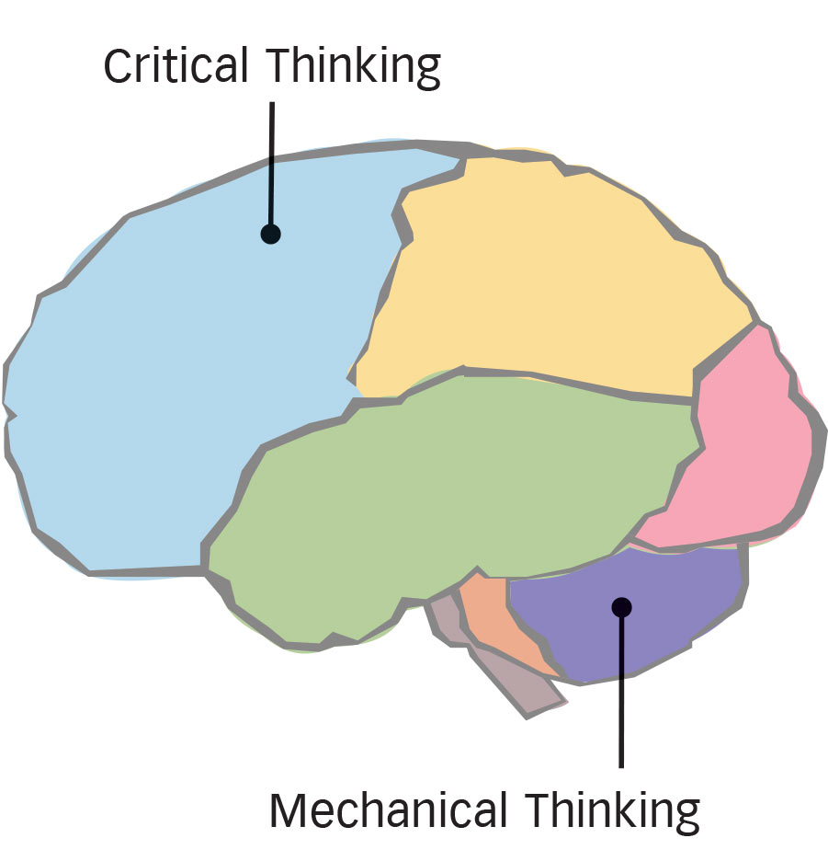
Breaking Mechanical Thinking
Mechanical thinking is routinized and reactionary: Whenever this happens, I do that. Mechanical thinking works from muscle memory, which is a good thing when doing physical tasks like walking, eating, or typing but not a good thing for decision making and critical thought. Mechanical thinking comes from the lower part of your brain. Critical thinking occurs in the upper part of your brain.

Slide 18
Breaking Mechanical Thinking
How can I recognize mechanical thinking?
Recognize recurrent thoughts, especially statements that close off possibilities. Often, they are cliches—worn-out expressions with no new thought. Replace recurrent statements with open-ended questions.

Slide 19
Breaking Mechanical Thinking
How can I recognize mechanical thinking?
Don't Say | Say
Everybody knows that . . . This is the only way. We always do it this way. There is no point. It is what it is. Nothing ever changes. | What possibilities are there? How else could we . . . ? What other way could we do it? What is our goal? How can we fix it? What can we change?

Slide 20
Breaking Mechanical Thinking
How can I recognize “groupthink”?
“Groupthink” is a specific type of mechanical thinking that happens in meetings. Groupthink suppresses individual contributions and insights in the rush to consensus. This problem occurs for a number of reasons.

Slide 21
Breaking Mechanical Thinking
How can I recognize “groupthink”?
One member has more authority than others, so everyone agrees with the one member. (This results in “yes men” and “yes women.”)
All of the members bring the same perspective to the table, so only one point of view is present. (A roomful of engineers will come up with an engineering solution.)
The members of the group don't have sufficient knowledge to address the situation. (This results in uninformed decisions.)

Slide 22
Breaking Mechanical Thinking
How can I recognize “groupthink”?
Everyone has the same fundamental assumptions, or those who challenge the fundamental assumptions are marginalized until they decide they are wrong.
The stated goal of the group (to solve a problem) differs from the unstated goals of the members (to get to lunch).
The group does not allow differences of opinion, or everyone just wants to “get along.”
When you encounter groupthink, try to get to the root of it. Perhaps ask to get fresh perspectives involved, or suggest going to the people who know most about the issue.

Slide 23
Activity 3: Stop Mechanical Thinking

Slide 24
My Goal
To use Socratic questions to spur individuals and groups to deeper thought

Slide 25
Using Socratic Questions
One way to break mechanical thinking and avoid groupthink is to ask Socratic questions to explore an idea from different angles.
What are Socratic questions?
Socratic questions were used by the Greek philosopher Socrates to help his students think more deeply. These questions come in six basic forms:

Slide 26
Using Socratic Questions
What are Socratic questions?
Clarifying questions ask what exactly a person means.
What’s another way we could phrase that?
Could we think of an example?
What do we mean here, exactly?

Slide 27
Using Socratic Questions
What are Socratic questions?
Assumption questions probe underlying ideas.
Are we assuming that ________?
Could we explain why/how _______?
At root, what do we want to happen?

Slide 28
Using Socratic Questions
What are Socratic questions?
Reasoning questions trace the logic of an idea.
What is the cause of ________?
What evidence shows that ________?
What is the reason for ________?

Slide 29
Using Socratic Questions
What are Socratic questions?
Perspective questions shift the point of view.
How would the opposition see the issue?
What would we have thought of that idea two years ago?
What would happen if we turned this idea around?

Slide 30
Using Socratic Questions
What are Socratic questions?
Consequence questions ask what might happen.
What could result from that change?
What is the value of ____________, and why?
When this takes place, how will people respond?

Slide 31
Using Socratic Questions
What are Socratic questions?
Recursive questions return to the original question.
Why are we asking this question?
Why do we think this question is key?
How did we become focused on this to begin with?

Slide 32
Using Socratic Questions
How should I use Socratic questions?
When you are working in a team that is not thinking deeply, you can use occasional Socratic questions to delve deeper. Recognize that any Socratic question that contains the word “you” can sound like a challenge, so be careful to frame your questions using inclusive pronouns like “we” and “us.”

Slide 33
Activity 4: Use Socratic Questions

Slide 34
My Goal
To recognize and manage the emotional aspect of thinking

Slide 35
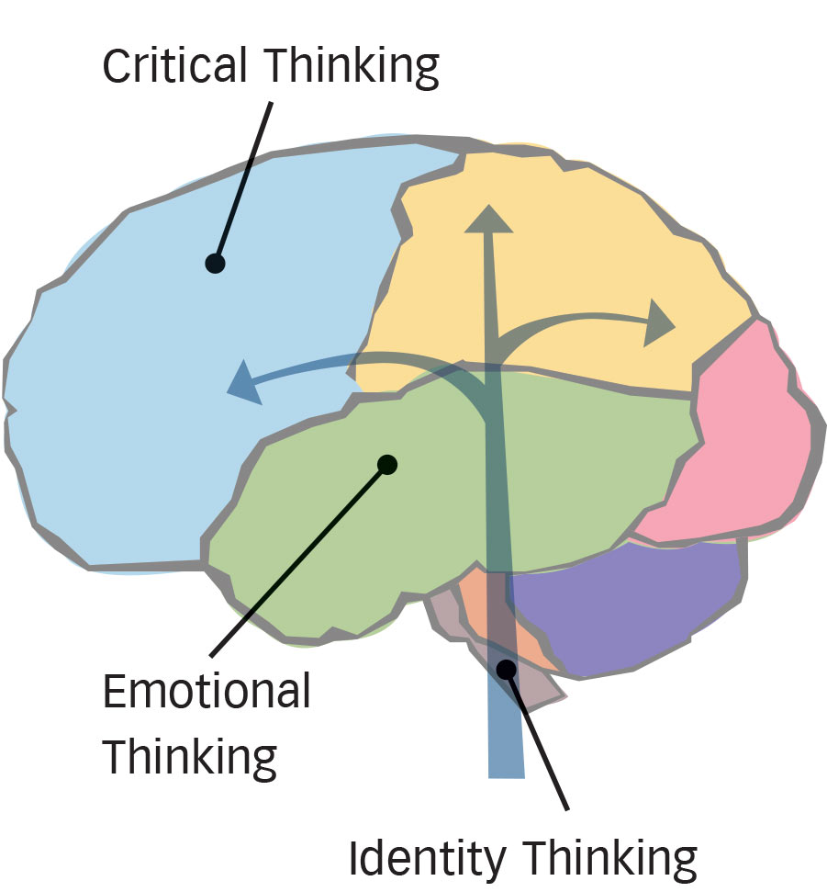
Managing Emotional Thinking
Critical thinking is possible only if you can recognize and manage your emotional thinking.

Slide 36
Managing Emotional Thinking
What is emotional thinking?
Emotional thinking results when your feelings drive your thinking. Often, we know how we feel before we know what we think, and so our thinking becomes a rationalization of the feeling. We say, “I hate that idea.” Then someone asks why, and we are forced to come up with reasons for our feeling rather than thinking objectively.

Slide 37
Managing Emotional Thinking
Why does emotional thinking occur?
Emotional thinking is the natural result of the way our brains are built. Take another look at the brain diagram. As you’ve seen, critical thinking takes place in the cerebrum, but impulses reach the cerebrum by going first through the brain stem (the center of identity) and then through a collection of glands and structures called the limbic system (the center of emotion). In other words, before you can think critically about anything, you have your first thoughts, “What does this mean to me?” and “How do I feel about this?” There is an emotional component to all thought. You can’t get rid of it, but you can recognize it and manage it.

Slide 38
Managing Emotional Thinking
How do I manage emotional thinking?
Follow this simple, four-step process:
Identify the emotion you are feeling: You might be happy, sad, fearful, angry, hopeful, regretful, desiring, dreading. . . .
Identify the cause of the emotion: Emotion usually relates to you or to people, objects, or ideas that are important to you.

Slide 39
Managing Emotional Thinking
How do I manage emotional thinking?
Note whether the emotion is appropriate in type and scale: Does the emotion fit the situation? Is it an underreaction, an appropriate reaction, or an overreaction.

Slide 40
Managing Emotional Thinking
4. Decide how to manage the emotion:
Express the emotion but set it aside to think critically.
“I'm feeling very nervous about that idea, but let's explore it.”
Modulate the emotion to better match the situation.
“I love this concept, but I have to look at it critically.”

Slide 41
Managing Emotional Thinking
Decide how to manage the emotion:
Use the emotion to engage the task.
“I’m determined to get this problem solved.”
Let your emotion connect you with others.
“I feel bad that this happened to you. Let’s prevent this kind of thing.”
Recognize that emotion will play a part in decision making.
“In the end, I have to be happy with the result, and I'm currently not happy with it.”

Slide 42
Activity 5: Manage Emotional Thinking

Slide 43
My Goal
To learn ways to remember names and get hold of new information

Slide 44
Using Memory Techniques
As you saw in Bloom’s taxonomy, the first level of critical thinking is remembering. Until you can remember information, you can’t work with it on deeper and deeper levels. You can’t fix an engine if you don’t remember what the parts do.

Slide 45
Using Memory Techniques
How can I memorize new information?
You need to shift information from short-term memory to long-term memory, using one or more of the following techniques:
Get your senses involved. When you just read something, only your visual sense is engaged. When you also hear it, another part of your brain fires. Speak it and write it to get touch and motor senses involved.

Slide 46
Using Memory Techniques
How can I memorize new information?
Connect emotionally. Emotion makes memory stronger. If you find an emotional connection for a piece of information, the information will stay solidly in your mind.
Practice in different locations. Information that applies to only one context does not get stored broadly in the brain. Study in different locations to store information more broadly.

Slide 47
Using Memory Techniques
How can I memorize new information?
Use spaced repetition. Review the information at different times to move it from short- to long-term memory.
Share the information. Our brains are social organs: They desire to share new information. Information becomes real when it is shared, and the best way to learn something is to teach it.

Slide 48
Using Memory Techniques
How can I memorize new information?
Use it or lose it. Your brain doesn’t just forget things. It actively culls memories that it no longer needs, kind of like deleting old email messages. To hold onto information, you need to use it.

Slide 49
Using Memory Techniques
How can I remember people’s names?
Use one or more of the following techniques:
Repeat the name: When you are first introduced to someone, listen for the person’s name, and then speak it back to the person as you shake hands. “Rob, it’s great to meet you.” Try to use the name once more in the next minute. “Hey, Rob, here’s something I really want you to see.” This process sends the name through your auditory and oral neurons.

Slide 50
Using Memory Techniques
How can I remember people’s names?
Write it and read it: As soon as you get a chance, write the person’s name down. Then read it quietly. This process sends the name through your visual and motor neurons.
Associate the name: Think of someone you know who has the same first name, and picture the two people’s faces overlaid. You can also relate the name to a trait. For example, “Caroline” may have a nice voice, so you can think of her as “Caroling Caroline.”

Slide 51
Activity 6: Use Memory Techniques

Slide 52
My Goal
To deepen my understanding about any workplace topic

Slide 53
Building Understanding
Memory is simple recall of information. Understanding goes beyond memory. To understand something is to know what it means, grasp its significance, and see how it fits in with other things.

Slide 54
Building Understanding
How can I deepen my understanding?
You deepen your understanding of any topic by examining it closely. To better understand an object or idea, seek answers to the following questions:

Slide 55
Building Understanding
How can I deepen my understanding?
What is its identity?
Name: What is it called? What other names apply?
Definition: What exactly is it? How is it unique?
Description: How can I express it? How can I paraphrase?
Category: What group does it belong in?
Taxonomy: How does its group connect to other groups?

Slide 56
Building Understanding
How can I deepen my understanding?
What form does it take?
Appearance: What does it look like? What color is it?
Style: What variety is it? What does its form “say” about it?
Composition: What is it made of?
Age: How old is it? When did it originate?
State: What is its current condition?
Shape: How is it formed?
Size: How big is it? How does its size compare?
Weight: How heavy is it? How important?
Volume: What does it encompass? What does it require?
Temperature: How hot or cold is it?
Velocity: How fast or slow is it?

Slide 57
Building Understanding
How can I deepen my understanding?
What function does it have?
Purpose: Why is it here? What’s its reason for being?
Use: What is its practical application?
Origin: Where did it come from? Who or what made it?
History: What has happened to it? How has it changed?
Future: How will it function in the future? How will it change?
Value: What is its worth? How scarce is it?
Quality: How does it compare to similar things?
Cause: What brought it into being?
Effect: How has it changed things?

Slide 58
Building Understanding
How can I deepen my understanding?
What context does it appear in?
Location: Where is it? What is all around it?
Sequence: What comes before it? What comes after?
Prevalence: How common is it? Where else is it?
Version: How has it been improved? How should it be?
Association: What other things are like it?

Slide 59
Activity 7: Investigate to Understand

Slide 60
Activity 8: Lesson Wrap-Up

Slide 61
Lesson 2
Deeper Thinking on the Job
Lesson Preview
Applying Ideas
Analyzing with Graphic Organizers
Evaluating with Traits
Evaluating with SCAMPER
Creating in Three Ways
Understanding Problem Solving

Slide 62
My Goal
To learn techniques for planning and applying ideas

Slide 63
Applying Ideas
Applying ideas means putting them to work in a real situation. As we all know, reality can be messy, but you can use a planning sheet to apply an idea to any situation, small or big.

Slide 64
Applying Ideas
How can I use a planning sheet?
Start by writing a goal statement: a single sentence that indicates what you want to do and why. Then flesh out your goal by answering who, what, where, when, why, and how about it. Afterward, list tasks that need to be accomplished and projected times when they will be accomplished. Note the team that will work on the project and the tools to use.

Slide 65
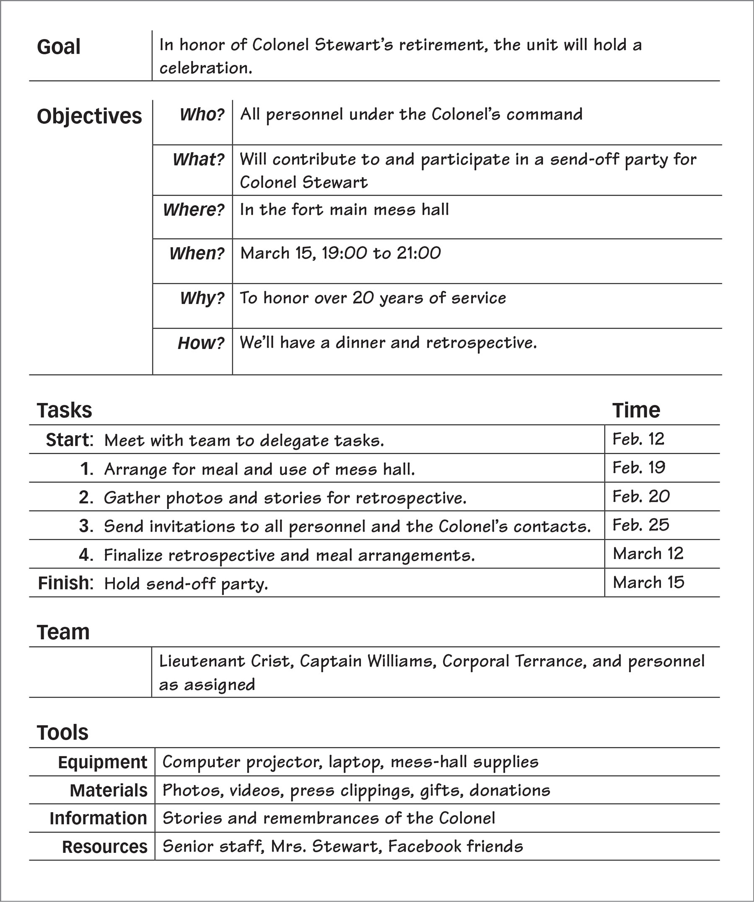
Applying Ideas
Planning Sheet

Slide 66
Activity 9: Apply Ideas

Slide 67
My Goal
To use thought tools to analyze a workplace topic

Slide 68
Analyzing with Graphic Organizers
When you analyze something, you take it apart, notice how the pieces connect and fit, compare and contrast parts, and trace causes and effects. You thoroughly study what you are thinking about.

Slide 69
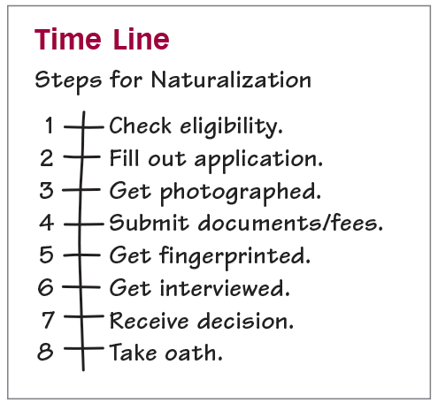
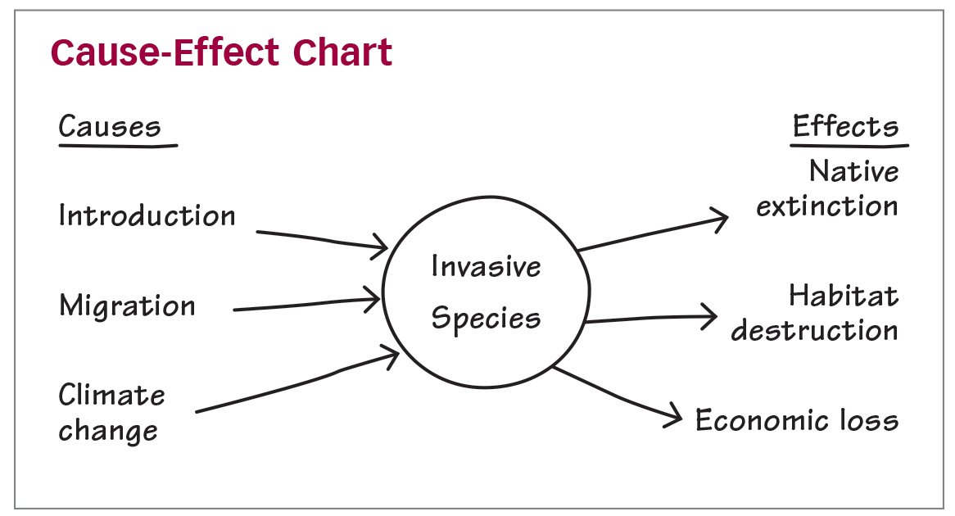
Analyzing with Graphic Organizers
How can graphic organizers help me?
Graphic organizers help you visualize your thinking. Each organizer provides a different kind of analysis of your topic.

Slide 70
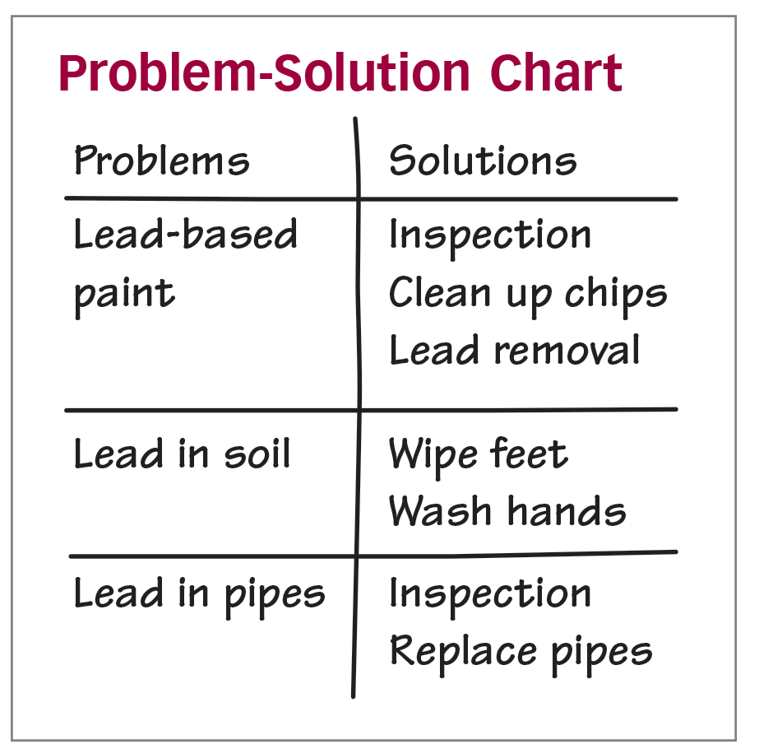
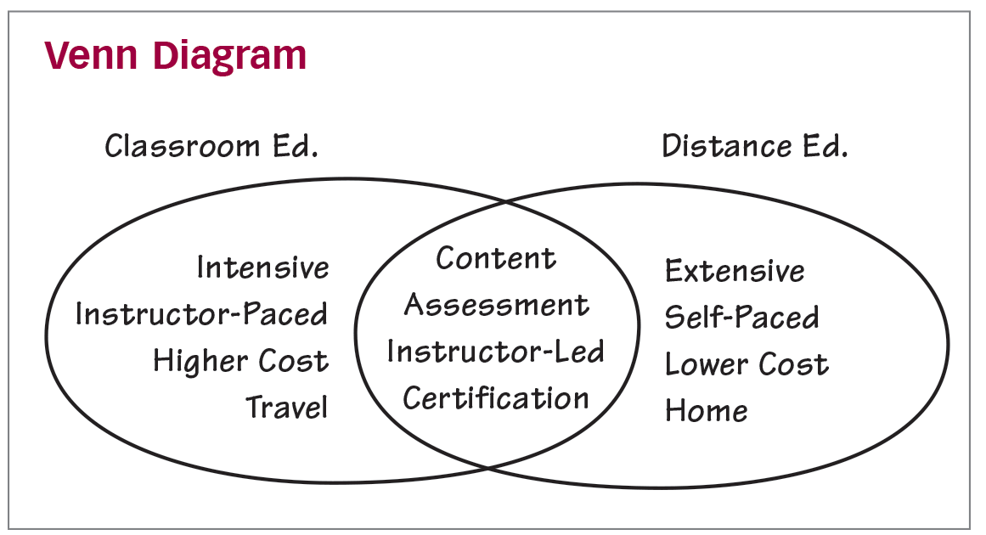
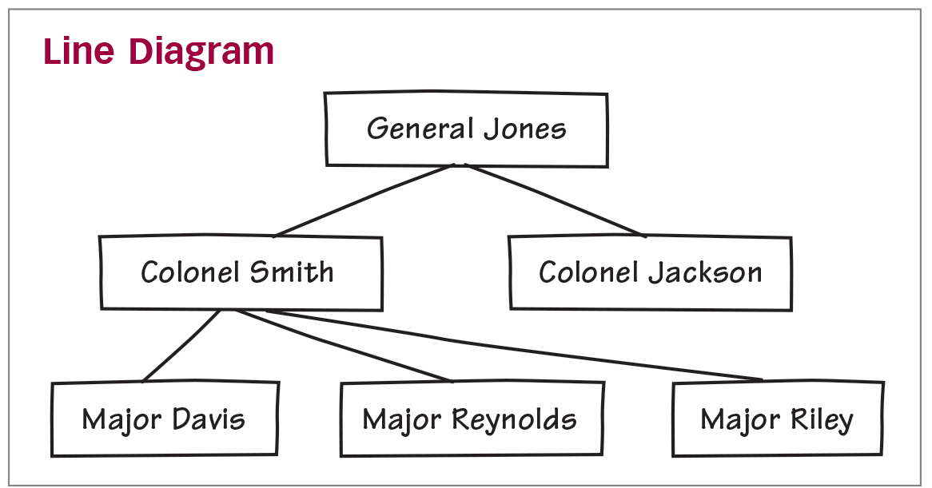
Analyzing with Graphic Organizers
How can graphic organizers help me?

Slide 71
Activity 10: Analyze with Graphic Organizers

Slide 72
My Goal
To use the traits of a topic to evaluate it and discover ways to improve it

Slide 73
Evaluating with Traits
You just learned about analyzing, which involves separating a topic into parts and examining how those parts fit together. Once you have analyzed something, you are better prepared to evaluate it.
To evaluate means to judge something’s value or worth, deciding whether it is useful, helpful, or effective—or not. Critical thinkers make fair and thoughtful evaluations.

Slide 74
Evaluating with Traits What is a trait? One way to evaluate something is to judge it against a set of desired traits. A trait is any quality or characteristic of something. For example, a trait of a new car could be its fuel efficiency. A car has many other traits—safety, comfort, color, engine power, just to name a few. Each one of those traits could be used to evaluate the quality of the car.

Slide 75
Evaluating with Traits
How do I evaluate with traits?
You can use traits to evaluate something by creating a trait-evaluation chart.
The left-hand column lists key traits related to your topic. Remember, the traits you choose set the standard for your evaluation, so it is important to pick ones that are most important to you or the situation.
The center column evaluates the topic’s worth based on each trait. As you evaluate, think about the most desirable aspect of the trait and rate your topic on whether or not it meets that standard.
The right-hand column lists ideas for improving the subject so that it more fully reflects each ideal trait.

Slide 76
Evaluating with Traits
How do I evaluate with traits?
Traits | Evaluation | Improvements
Productivity | I am doing more work in less time, though my kids interrupt my workflow more than I’d like. | I could rehire our old baby sitter to look after my kids during my work hours.
Morale | Teleworking saves me a two-hour commute. I get more sleep and feel less stress. However, I am isolated from my agency and colleagues. | I could make monthly trips to my agency’s office. I could also ask my manager to include me in meetings via speakerphone or videoconferencing.

Slide 77
Evaluating with Traits
How do I evaluate with traits?
Traits | Evaluation | Improvements
Workspace | My home office is great but I need a second phone line for work purposes. | I could write a proposal seeking approval for my agency to expense a second phone line.
Cost Effectiveness | My salary is the same, though I save on gas and travel. I had to buy a new computer but the savings make up the difference. | None.

Slide 78
Activity 11: Evaluate with Traits

Slide 79
My Goal
To use the SCAMPER questions to think of ways to improve a product, service, process, or concept

Slide 80
Evaluating with SCAMPER
A researcher named Bob Eberle created a set of questions that you can use to evaluate something and think of ways to improve it. The first letter in each type of question spells out the word SCAMPER.
How can SCAMPER improve something?
Ask one or more of the SCAMPER questions about a product, service, procedure, or concept from your company. Apply some of your answers.

Slide 81
Evaluating with SCAMPER
How can SCAMPER improve something?
Substitute | What alternatives can we discover? Who else could be involved with this issue? What other ideas, approaches, or materials could be useful? What new goals should we focus on?
Combine | How can this be combined with something else? How would this work if it were more like that? How can this be used in a new context? How can this idea connect to other people?

Slide 82
Evaluating with SCAMPER
How can SCAMPER improve something?
Adapt | What changes would improve this? How could this be modified to better fit the situation? What traits could be adjusted to improve this? How can this become more desirable?
Magnify | How can this be made bigger or more powerful? How can I improve performance or efficiency? How can I make this faster? How can I make this more impressive?

Slide 83
Evaluating with SCAMPER
How can SCAMPER improve something?
Put to Other Uses | What other uses does this have? Who else could use this? Where else could this be applied? What other problem could this solve?
Eliminate | What would simplify this? What would streamline it? How can it become less costly? What would make this more subtle?
Rearrange | What other sequence could work for this? How could I turn this completely around? What other part of the issue might be more important? Could this happen at a different time or in a different place?

Slide 84
Activity 12: Use SCAMPER

Slide 85
My Goal
To understand three basic approaches to creating, know their best uses, and be aware of caveats

Slide 86
Creating in Three Ways
The act of creating is the deepest and most involved form of critical thinking. It requires all of the other critical thinking skills. The act of creating also requires our creative thinking skills.

Slide 87
Creating in Three Ways
What are three ways to create?
There are three basic approaches to creating something: building, growing, and exploring. The best approach depends on the situation and the person who is doing the work. At times you’ll use all three approaches during the same project.
The chart on the next slide describes the three approaches to creating. The “example” column shows how the Navy Supply Corps might use each approach.

Slide 88
Creating in Three Ways
What are three ways to create?
Ways to Create | Caveat | Caveat | Caveat | Example
Building | When you build something, you start with critical thinking. You set precise goals, make careful plans, gather the materials you need, and work steadily at creating. | This approach works best when materials are expensive, schedules are tight, and results are well defined. | When building something, don’t be ruled solely by your plans. Be ready to take opportunities that arise. | A Navy Supply Corps accountant creates an audit report of existing supplies.

Slide 89
Creating in Three Ways
What are three ways to create?
Ways to Create | Description | Best Use | Caveat | Example
Growing | When you grow something, you use critical thinking and creative thinking hand in hand. You have a plan, but you also watch things develop and adapt as you go. | This approach works best when factors aren’t completely within your control and some unknowns exist. | When growing something, you need to constantly tend your project and react as it changes. | An officer creates an inventory request form. This job requires attention to changes in supply and demand and the ability to forecast future needs.

Slide 90
Creating in Three Ways
What are three ways to create?
Ways to Create | Description | Best Use | Caveat | Example
Exploring | When you explore something, you lead with your creative thinking. You set off with a minimal plan and the desire to discover, react, and improvise. | This approach works well when the results are unknown, time is abundant, and materials are cheap. | When exploring, you must dynamically adapt to an ever-changing situation. Be ready for waste and trimming. | The officer explores better ways to utilize space in a storage area to fit new inventory.

Slide 91
Creating in Three Ways
How should I use the ways?
Decide on building, growing, or exploring as the situation dictates. For larger projects, you’ll do all three. You might start by exploring options available to your department, then build a proposal for taking advantage of one option, and then grow a team to handle implementation.

Slide 92
Activity 13: Create in Three Ways

Slide 93
My Goal
To use a series of critical- thinking steps to solve problems

Slide 94
Understanding Problem Solving
Problems abound in the workplace, and often your job is defined by the problems that you solve. The problem-solving process isn’t magic. It’s a series of critical-thinking steps that you have been practicing.

Slide 95
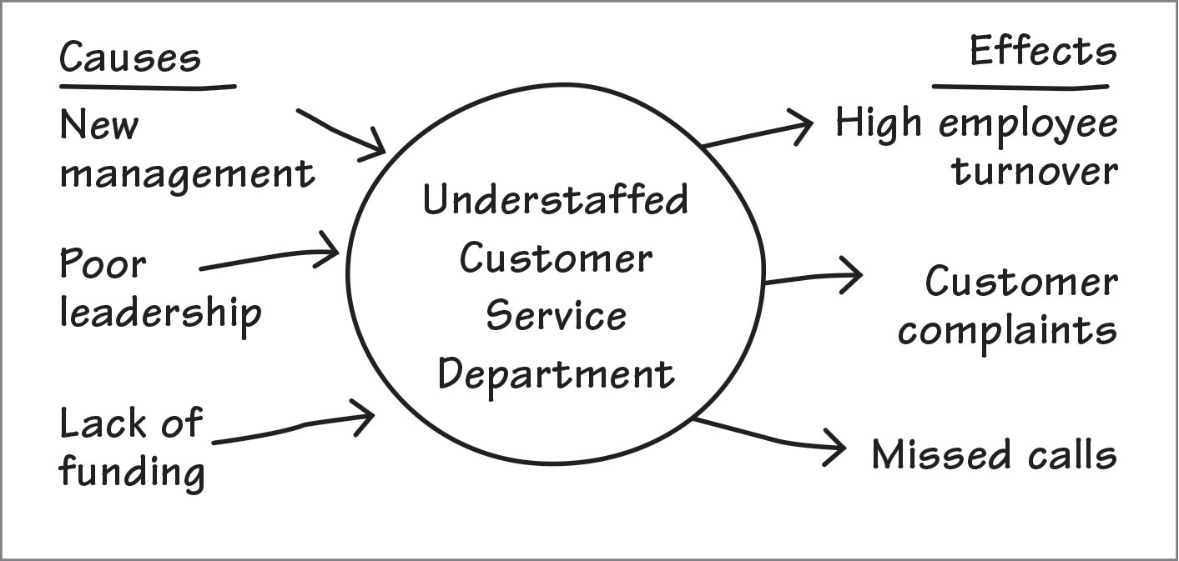
Understanding Problem Solving
How can I solve workplace problems?
The following series of steps can help you solve workplace problems both small and big.
Define the problem. Identify the key issues (such as type, origin, history, extent) and analyze the problem’s causes and effects:

Slide 96
Understanding Problem Solving
How can I solve workplace problems?
Brainstorm solutions. List in as many ways as you can how the problem could be solved. Consider ways to eliminate causes, lessen effects, or both.
Plan your solution. Choose one of your brainstorming ideas. Decide on a goal and answer who, what, where, when, why, and how about it. Think about the tasks you’ll need to accomplish to reach the goal, the time each task will take, the team available to help, and the tools you will need. For complex projects, consider gathering this information on a planning sheet.

Slide 97
Understanding Problem Solving
How can I solve workplace problems?
Create your solution. Build it, grow it, explore it, or do all three, depending on the situation.
Evaluate your solution. Check the solution against your goal. Have you reached it, exceeded it, fallen short? Use a trait evaluation. How could the solution be more effective and efficient? Use the SCAMPER questions.
Make improvements. Upgrade your solution so that it works optimally and the problem is well and truly solved.

Slide 98
Activity 14: Solve Problems

Slide 99
Activity 15: Lesson Wrap-Up

Slide 100
Lesson 3
Logic at Work
Lesson Preview
Separating Fact from Opinion
Building Logical Arguments
Recognizing Assumptions
Reasoning Deductively
Reasoning Inductively
Avoiding Logical Fallacies
Appealing to Your Audience
Reaching Resistant Audiences

Slide 101
My Goal
To distinguish statements of fact from opinion in arguments

Slide 102
Separating Fact from Opinion
An important aspect of critical thinking is identifying, constructing, and evaluating arguments. An argument presents a series of connected statements to establish a belief or position. Some arguments use facts to work toward a conclusion. Other arguments offer opinions in hopes of convincing others to agree with a point of view.

Slide 103
Separating Fact from Opinion
What is a fact?
A fact is a statement of truth that can be objectively proven based upon evidence. A factual statement is not debatable; it is either true or false.
The Chicago Transit Authority’s “L” has the third highest weekday ridership of all rapid transit systems in the United States.

Slide 104
Separating Fact from Opinion
How can I use facts to build an argument?
Fact-based arguments use a series of factual statements to establish the truth of a conclusion.
Statement 1: Only candidates with a bachelor’s degree from an accredited college or university are considered for a job as a public health advisor.
Statement 2: Tasha is a public health advisor.
Fact-based conclusion: Tasha has a bachelor’s degree.

Slide 105
Separating Fact from Opinion
What is an opinion?
An opinion is a personally held attitude or belief. An opinion cannot be objectively proven but can be supported by logical thought and reliable evidence.
The Chicago Transit Authority’s “L” is the best rapid transit system in the United States. (This statement is a personal opinion of the writer and cannot be proved objectively, though the writer may have reached this conclusion through sound logic.)

Slide 106
Separating Fact from Opinion
How can I use opinions to build an argument?
Opinion-based arguments focus on a debatable statement, which can be explained and defended so that others will agree with it. A strong opinion generates appeal through logical arguments and supporting evidence.

Slide 107
Separating Fact from Opinion
How can I use opinions to build an argument?
Opinion statement: The Chicago Transit Authority’s “L” is the best rapid transit system in the United States.
Support 1: Three-quarters of a million people ride the “L” every weekday.
Support 2: Chicago’s densely packed skyscrapers—a key feature of the city—were made possible by the “L.”
Support 3: The elevated sections in the Loop give riders an unparalleled view of downtown Chicago.

Slide 108
Activity 16: Separate Fact from Opinion

Slide 109
My Goal
To use premises, inferences, and conclusions to construct a logical argument

Slide 110
Building Logical Arguments
An argument is composed of three basic parts: premises, inferences, and conclusions.

Slide 111
Building Logical Arguments
What is a premise, and how can I use it?
A premise is a statement that is accepted as true. Think of premises as support beams for an argument. Logical premises provide strong support; untruthful premises provide a shaky foundation.
When building an argument, you don’t seek to prove the truth of a premise; rather, you accept it as so and use it to build a stronger case for a larger point. You can identify a premise by imagining the word “if” in front of it.

Slide 112
Building Logical Arguments
What is a premise, and how can I use it?
Premise 1: (If) Mechanical thinking is static and reactionary.
Premise 2: (If) Complacency of thought stifles decision making and deep thought.
Premise 3: (If) Critical thinking breaks the routine of mechanical thinking.

Slide 113
Building Logical Arguments
What is an inference, and how can I use it?
An inference is a statement that is derived from previous statements—whether premises or other inferences. The truth of an inference is based on the truth of the statements that it is derived from.

Slide 114
Building Logical Arguments
What is an inference, and how can I use it?
Premise 1: (If) Improved critical thinking leads to job success.
Premise 2: (If) You are an employee of the Federal government.
Inference 1: (Then) Improving your critical thinking skills will make you a more successful Federal employee.
Premise 3: (If) Critical thinking strategies can be used to improve decision making and problem solving.
Inference 2: (Then) You can use critical thinking strategies to make better decisions and solve problems at work.

Slide 115
Building Logical Arguments
What is a conclusion?
A conclusion is a final inference, derived from the previous statements. Identify a conclusion by imagining the word “Then” in front of the final inference.

Slide 116
Building Logical Arguments
What is a conclusion?
Premise 1: (If) Critical thinking deepens thinking in and out of work.
Premise 2: (If) The Critical Thinking participant guide teaches proven critical thinking strategies.
Conclusion: (Then) Your course-completion certificate shows that you possess the tools to deepen your thinking in and out of work.

Slide 117
Activity 17: Use Premises, Inferences, and Conclusions

Slide 118
My Goal
To recognize and clarify hidden assumptions in arguments

Slide 119
Recognizing Assumptions
Sometimes assumptions needed to make an argument complete are left unstated. Recognizing hidden assumptions can help you…
understand all the pieces that hold an argument together.
evaluate the strength or weakness of an argument.
recognize your own assumptions when building arguments.

Slide 120
Recognizing Assumptions
What is a hidden assumption? A hidden assumption is an unstated premise that is necessary to the argument but is not explicitly stated.

Slide 121
Recognizing Assumptions
What is a hidden assumption?
Argument: Providing employees with a 15-minute personal break will recharge their minds and boost productivity.
Hidden Assumption: More production is needed from employees.
Argument: The area is restricted to National Park Rangers because of the steep incline and loose rocks.
Hidden Assumption: National Park Rangers are trained for these conditions, so it is not a danger to them.

Slide 122
Recognizing Assumptions
What is a hidden assumption?
Just because an assumption is hidden doesn’t mean it is right or wrong. However, only when you recognize the hidden assumption can you make a fair evaluation of the argument as a whole.

Slide 123
Recognizing Assumptions
How can I recognize hidden assumptions?
There are two steps to identifying hidden assumptions in arguments.
Step 1. Check the argument’s validity. Does the conclusion derive from premises? Do the premises show explicitly the assumptions needed to derive the conclusion? If you answer “yes” to both questions, the argument is valid and no hidden assumptions are involved. If you answer “no” to either question, the conclusion must derive from at least one hidden assumption.

Slide 124
Recognizing Assumptions
How can I recognize hidden assumptions?
Step 2. Identify any additional premises needed to make the argument valid. Those are the hidden assumptions.
Premise 1: (If) It is Presidents’ Day.
Premise 2: (If) All Federal employees are off on Presidents’ Day.
Premise 3: (If) Justin is not working today.
Premise 4: (If) Justin works in Washington, D.C.
Conclusion: (Then) Justin must be a Federal employee.

Slide 125
Recognizing Assumptions
How can I recognize hidden assumptions?
The conclusion is not valid, because someone who works in Washington, D.C., could be off on Presidents’ Day and not be a Federal employee.
Hidden Assumption: Anybody who works in Washington, D.C., is a Federal employee.
As you can see from the above example, pointing out a hidden assumption doesn’t automatically make the argument stronger. However, it clarifies the argument and makes it easier to evaluate.

Slide 126
Activity 18: Recognize Assumptions

Slide 127
My Goal
To learn how to make an argument that guarantees its conclusion

Slide 128
Reasoning Deductively
A deductive argument guarantees its conclusion. It starts out with a series of general premises to explain a specific conclusion. If the premises and inferences in the argument are true, the conclusion will be true.

Slide 129
Reasoning Deductively
How does deductive reasoning work?
Most often, deductive reasoning begins with a general premise and moves toward a specific conclusion. This line of reasoning guarantees its conclusion.
General
specific

Slide 130
Reasoning Deductively
How does deductive reasoning work?
General Premise: All oceans are bodies of water.
General Premise: All ocean water contains a high concentration of salt.
Specific Premise: The Atlantic is an ocean.
Specific Conclusion: The Atlantic Ocean contains a high concentration of salt.

Slide 131
Reasoning Deductively
How does deductive reasoning work?
If the three premises are true, the conclusion is true. Likewise, if the premises are true and the inferences and conclusion are properly derived, then the conclusion must be true.

Slide 132
Reasoning Deductively
How does deductive reasoning work?
General Premise: All business travel must be authorized by a supervisor within the agency.
Specific Premise: A Department of Interior accountant traveled to Houston, Texas, for an auditing assignment.
Specific Inference: The Department of Interior accountant received authorization to travel.
Specific Premise: Mr. Anderson is the supervisor for the agency.
Specific Conclusion: Mr. Anderson authorized the auditor’s trip to Houston.

Slide 133
Reasoning Deductively
Why are deductive arguments strong?
A deductive argument is strong because it is cannot be picked apart. As long as the premises and inferences are true, the conclusion will be true. Deductive arguments can build upon each other by using the conclusion of one argument as a premise in another.

Slide 134
Reasoning Deductively
How can deductive arguments be weak?
The problem with deductive arguments is that the conclusions are contained within the premises. The argument can’t cover new ground. When you reason from general principles to a specific case, you learn about one case. To discover general principles you have to use induction, which is covered on pages 44-45.

Slide 135
Activity 19: Reason Deductively

Slide 136
My Goal
To create arguments using evidence that points to a new, general principle

Slide 137
Reasoning Inductively
An inductive argument does not guarantee its conclusion. Instead, it uses specific evidence (premises) to argue for a general point. Arguments based on specific observations or details generally work best when they are organized inductively.

Slide 138
Reasoning Inductively
How does inductive reasoning work?
Most often inductive reasoning works by presenting a series of specific details or observations to argue for a general rule or theory. Since inductive arguments move from specific to general, they do not guarantee their conclusions.
specific
General

Slide 139
Reasoning Inductively
How does inductive reasoning work?
Specific Premise: The Great Lakes are made up of fresh water.
Specific Premise: Lake Victoria is made up of fresh water.
Specific Premise: Lake Titicaca is made up of fresh water.
General Inference: The Great Lakes, Lake Victoria, and Lake Titicaca are lakes.
General Conclusion: All lakes are made up of fresh water.

Slide 140
Reasoning Inductively
How does inductive reasoning work?
Though the conclusion may seem correct, the fact is that there are saltwater lakes. All four premises are true, but the conclusion is not true. Instead, the conclusion is more of a hypothesis—a general principle derived from a set of observations. The hypothesis can then be tested and proved or disproved.
That’s not to say all inductive arguments are flawed. Often inductive arguments tackle topics that are too broad for deductive arguments. In fact, inductive reasoning often yields creative discoveries.

Slide 141
Reasoning Inductively
How does inductive reasoning work?
Specific Premise: The 108th block of North Avenue has had four reported cases of violent crime in the last month.
Specific Premise: Three months ago the police department targeted the area and sent more officers to patrol it.
General Inference: The increased police surveillance has not prevented violent crime.
General Conclusion: The police department should implement new measures for preventing violent crime on the 108th block of North Avenue.
In this example, someone may agree with the premises but suggest a different conclusion.

Slide 142
Reasoning Inductively
What is the strength of induction?
Inductive arguments start with specific observations and derive general conclusions, a process similar to scientific discovery. The conclusions act as hypotheses, which, when tested, can turn into theories or even laws. They also tackle complex issues that deductive arguments cannot address.

Slide 143
Reasoning Inductively
What is the weakness of induction?
As you have learned, inductive arguments can only support their conclusions rather than proving them as fact.

Slide 144
Activity 20: Reason Inductively

Slide 145
My Goal
To recognize and avoid faulty logic

Slide 146
Avoiding Logical Fallacies
Faulty logic derails arguments. You should avoid logical fallacies in your own arguments—and recognize them in the arguments of others.

Slide 147
Avoiding Logical Fallacies
What faulty logic should I avoid?
An appeal to ignorance argues that a conclusion is true because no one can disprove it, or that the conclusion is false because no one has proven it.
No one has found a cure for cancer, so there must not be one.
Bandwagoning is using peer pressure to convince someone to take action.
Every other agency is boosting its social-media presence; clearly we need to boost ours.

Slide 148
Avoiding Logical Fallacies
What faulty logic should I avoid?
A bare assertion claims that a certain view is the only right one and discounts the possibility of discussion.
Anyone who eats meat doesn’t care about animal rights. I don’t listen to animal haters.
A broad generalization is either a general rule based on limited evidence or a conclusion that does not allow for exceptions.
Today’s youth are coddled and can’t handle criticism.

Slide 149
Avoiding Logical Fallacies
What faulty logic should I avoid?
A false cause claims that one condition causes another when actually the two conditions are related only in a time sequence.
Since we rolled out our childhood obesity initiative, math proficiency scores have increased. Decreasing childhood obesity improves math education.
A half-truth misrepresents a situation by providing only part of the story.
Vaccinations have nearly eliminated polio and whooping cough. There is no need for children to get vaccinated for them.

Slide 150
Avoiding Logical Fallacies
What faulty logic should I avoid?
Impressing with numbers is misusing statistics in order to draw attention away from a faulty argument.
The U.S. GDP of nearly $15 trillion added to the European Union’s GDP of over $16 trillion equals $31 trillion, which shows that China’s GDP of one-sixth that amount is fairly insignificant.
A non sequitur is a conclusion that does not follow logically from its premise.
Traffic accidents on I-85 have decreased by 25 percent since we added a lane and widened the existing ones. As a result, we need to reconsider our emergency evacuation plans.

Slide 151
Avoiding Logical Fallacies What faulty logic should I avoid? A slippery slope fallacy indicates one small step will lead to an unstoppable cascade of events.
If you grant Mark an extension for this one project, everyone will want an extension, and nothing will ever get done on time.

Slide 152
Activity 21: Avoid Logical Fallacies

Slide 153
My Goal
To learn how to appeal to my audience

Slide 154
Appealing to Your Audience
Logic is only the first part of persuasion. The second part is understanding your audience. As Ben Franklin said, “If you would persuade, you must appeal to interest rather than intellect.” You can influence your audience when you understand what they want and need.

Slide 155
Appealing to Your Audience
How do I decide what my audience knows?
To fit your argument with the knowledge of your audience, ask yourself the following questions:
What does my audience know about this topic? If your audience is already knowledgeable about the subject, such as employees within your division or agency, don’t bore them with background and explanations. On the other hand, if you’re speaking to a general audience, tailor your message to the least knowledgeable audience member.

Slide 156
Appealing to Your Audience
How do I decide what my audience knows?
What does my audience need to know? Think about what you want your audience to do with the message.

Slide 157
Appealing to Your Audience
How do I decide what my audience needs?
Everyone shares a set of common needs. Abraham Maslow developed a hierarchy that spells out our most essential needs. The lowest level of the pyramid includes physical needs, which must be met before the next level becomes important, and so on. You can use the information on the pyramid to tailor your argument to your audience’s needs.

Slide 158
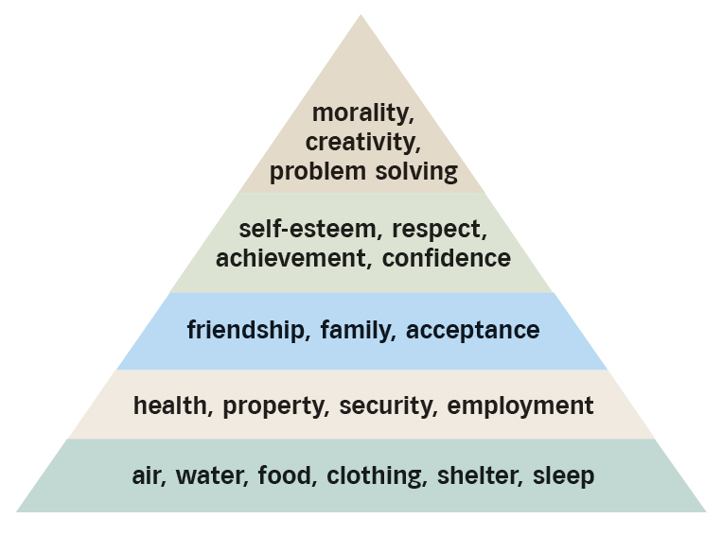
Appealing to Your Audience
How do I decide what my audience needs?

Slide 159
Appealing to Your Audience
How do I decide what my audience needs?
Topic
People of all ages in your community are taking the pledge to improve their health through weekly exercise. Studies show engaging in moderately strenuous exercise for just 30 minutes a day can greatly improve your overall health, mood, and ability to live an independent and satisfying lifestyle. Beyond the physical health benefits, daily exercise can improve your mental well-being, reduce stress, and increase energy levels so that you can perform better at work and maintain healthy relationships with family and friends. If you don’t want to exercise alone, consider joining an exercise team in your community to gain the support and motivation you need. Now’s the time to get moving. Join the Healthy People Movement today.
Appeal to health
Appeal to achievement
Appeal to family and friendship
Appeal to
self-esteem

Slide 160
Activity 22: Construct Appeals

Slide 161
My Goal
To understand how to reach resistant audiences

Slide 162
Reaching Resistant Audiences
There are times when influencing your audience requires more than appealing to their needs. Sometimes you will encounter audiences opposed to your position. To reach resistant audience members, you first need to recognize their objections to your position.

Slide 163
Reaching Resistant Audiences
How can I identify objections?
State your position—your persuasive main point—and then list all the reasons a person might not accept it.
Position:
To improve your health, you should exercise for at least 30 minutes a day.
Objections:
I don’t have enough money to buy a gym membership.
I’m too busy to exercise.
Who are you to tell me how to live my life?
I’m already healthy. I don’t need to exercise.

Slide 164
Reaching Resistant Audiences
How can I answer objections?
Start by recognizing that any objection your audience has relates to a need—perhaps for respect, achievement, confidence, or employment. Focus on that need, and answer any objection in one of the following ways.

Slide 165
Reaching Resistant Audiences
How can I answer objections?
Provide a solution to the problem.
You don’t need a gym membership to live an active lifestyle. Simply going on a walk around your neighborhood for 30 minutes is enough to maintain a daily active lifestyle. There are also plenty of free at-home exercises you could consider doing.

Slide 166
Reaching Resistant Audiences
How can I answer objections?
Show how the benefits outweigh the objection.
There’s no doubt that life throws a lot of responsibilities our way, and you may not feel you have the time or energy for exercise. However, you’ll quickly discover that spending 30 minutes on exercise increases your energy level so that you can get more done the rest of the day.
Concede the objection and move on.
We hope you will consider making exercise a part of your daily routine, but ultimately the final decision is up to you. How you live is your own choice.

Slide 167
Activity 23: Reach a Resistant Audience

Slide 168
Activity 24: Lesson Wrap-Up

Slide 169
Lesson 4
Critical Thinking in Teams
Lesson Preview
Helping Groups Think
Resolving Conflicts
Making Decisions
Applying Your Learning
Taking a Post-Assessment

Slide 170
My Goal
To understand how to lead and participate in groups’ critical thinking

Slide 171
Helping Groups Think
Whether you are leading a group or are participating in it, you can help the group think critically.
How can I lead groups in critical thinking?
Create an environment in which critical thinking is expected and valued. Follow these tips:

Slide 172
Helping Groups Think
How can I lead groups in critical thinking?
Establish your expectations for thinking.
“This is an important issue, so we all need to think critically about it.”
Monitor the stages of the problem-solving process.
“Remember, we’re still defining the problem. We need to fully understand it before we move to brainstorming solutions.”
Try to get everyone to contribute.
“Janice, you look skeptical. That’s fine. We need a reality check. What are you thinking?”

Slide 173
Helping Groups Think
How can I lead groups in critical thinking?
Give time for discussion, not rushing to make a decision.
“Let’s go back to our definition of the problem. What if we defined it in this way instead?”
Employ a consistent strategy for decision making.
“In the end, the decision is mine, but I want to make sure I’ve considered everyone’s perspective.”

Slide 174
Helping Groups Think
How can I help groups think?
Even if you are not the leader, you can help groups think critically by using the many thinking strategies you have learned. Follow these tips:
Contribute your ideas; don’t just sit silently.
“The third option sounds promising for three reasons.”
Listen carefully to others’ ideas instead of ruminating on what you will say next.
“Let me make sure I understand what you are saying. . . .”

Slide 175
Helping Groups Think
How can I help groups think?
Break through groupthink by challenging assumptions and bringing in other perspectives.
“When I spoke to my wife about this, she suggested . . .”
Carefully check the group’s premises, inferences, and conclusions, and point out hidden assumptions.
“We’re assuming that the budget cannot be increased.”
Recognize deductive and inductive reasoning, avoiding the pitfalls of each.
“The evidence does point toward that conclusion, but maybe we should test it. . . .”

Slide 176
Activity 25: Help Groups Think

Slide 177
My Goal
To understand the options for resolving conflicts

Slide 178
Resolving Conflicts
Conflicts are disagreements that occur when two or more people differ in their ideas about something. Ongoing conflicts can build to serious arguments or worse.
How can I define a conflict?
Start by staying calm. As you’ve seen, leading with your emotions makes your thinking serve your feelings. Recognize emotion, manage it, and think objectively about the situation.

Slide 179
Resolving Conflicts
How can I define a conflict?
Define the conflict by asking four questions:
What is the problem?
What is my purpose in the situation?
Who are the people involved?
Where is the conflict taking place?

Slide 180
Resolving Conflicts
How can I resolve conflicts?
You have options for resolving conflicts. Different situations call for different resolutions.
Cooperate with the other person, working for the common good. You might cooperate if . . .
you have common goals.
you mutually benefit.
you are on a team.
you need the same resources.

Slide 181
Resolving Conflicts How can I resolve conflicts?
Compromise with the other, each giving up something to meet in the middle. You might compromise if . . .
you have opposing goals.
you must move forward.
you are on opposite teams.
the other person is willing.

Slide 182
Resolving Conflicts How can I resolve conflicts?
Defer to the other if you do not have authority, are wrong, or consider the issue not worth fighting over. You might defer if...
you don’t have authority.
the issue isn’t a high priority.
you are in the wrong.
you feel the other person will be proven wrong.

Slide 183
Resolving Conflicts
How can I resolve conflicts?
Assert your position if you have authority, know you are right, or find alternatives unacceptable (but avoid insubordination). You might also assert if . . .
an idea is dangerous.
you or some else is falsely accused.
a policy is unfair
the evidence supports your argument.

Slide 184
Resolving Conflicts How can I resolve conflicts?
Compete with the other, each trying a different approach to see which works (but avoid insubordination). You might compete if...
you want the same thing.
you are on opposite teams.

Slide 185
Resolving Conflicts
What if I can’t resolve a conflict?
If you get into a workplace conflict that you’ve been unable to resolve, take your concerns to your superior. Don’t focus on being “right.” Instead, think of the department’s goals and indicate how the conflict is hampering them. It is in everyone’s best interest to resolve conflicts.

Slide 186
Activity 26: Resolve Conflicts

Slide 187
My Goal
To understand how groups make decisions and to facilitate the process

Slide 188
Making Decisions
Effective groups identify up front how decisions will be made. Different groups have different approaches.
What methods of decision making are there?
The style of a given group depends on who has power in the group. Often, one person is in charge, but in other groups, everyone shares responsibility for outcomes. Here are the four basic decision-making methods along with their pros and cons.

Slide 189
Making Decisions
What methods of decision making are there?
Method of Deciding | Pros | Cons
Authority Rule: The group discusses issues and may make recommendations. However, one authority figure—a leader or an invited expert—makes the decision. | This method is efficient. | Members may feel they don’t get a say.
Minority Rule: A vocal or powerful minority makes a decision that the majority may disagree with but feel forced to accept. | Even minority interests can be heard and have power. | This method may leave the majority feeling left out.

Slide 190
Making Decisions
What methods of decision making are there?
Method of Deciding | Pros | Cons
Majority Rule: The group votes, and whatever option crosses a threshold of votes wins. | This approach is fair but still efficient. | Those in the minority may feel reluctant to cooperate.
Consensus Rule: All group members agree to support a solution even though some may have reservations. | Group members feel included and valued. | This method may take time and discussion.

Slide 191
Making Decisions
How can I facilitate decision making?
Follow these tips:
Know the decision-making style of the group and what your position is within the group.
Remember the five conflict-resolution strategies: assert, defer, cooperate, compromise, and compete.
Help the group state a common goal, which puts the group on the path to cooperation.

Slide 192
Making Decisions
How can I facilitate decision making?
Recognize and stop mechanical thinking—your own and others’.
Recognize and manage emotional thinking—your own and others’.

Slide 193
Activity 27: Make Decisions

Slide 194
My Goal
To create a personal contract for applying what I have learned and continuing to improve

Slide 195
Applying Your Learning
You’ve worked hard and learned a lot, but now you need to apply your learning back on the job. By creating a personal contract, you will gain the most from this course.

Slide 196
Applying Your Learning
How can I create a personal contract?
You can create a personal contract by setting a few goals and outlining specifically what you will do to reach them. Here is a sample personal contract.

Slide 197
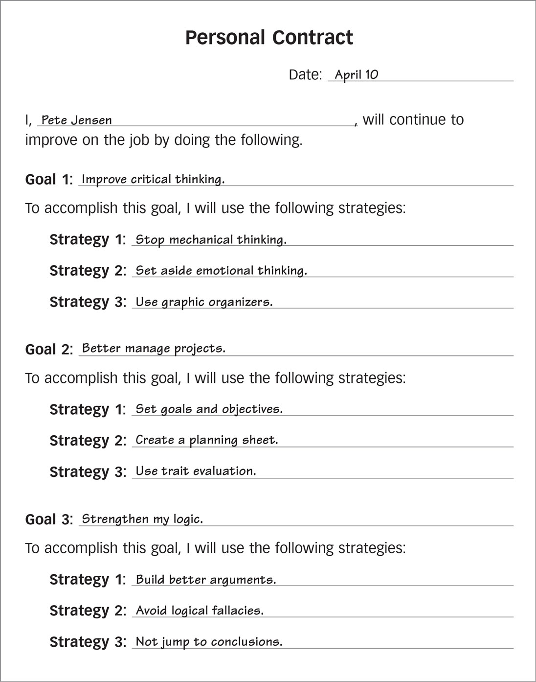
Applying Your Learning
Personal Contract

Slide 198
Activity 28: Create a Contract

Slide 199
Activity 29: Taking a Post-Assessment

