Slide 2
Table of Contents
Lesson 1
Lesson 2
Click here to return to previous slide.

Slide 3
Lesson 1
Using Best Practices
Lesson Preview
Using the Traits and Process
Following Effective Email Policy
Managing Email Communication
Avoiding Email Pitfalls
Using Plain Language
Writing Respectful Greetings and Closings
Analyzing Purpose, Reader, and Context

Slide 4
My Goal
To understand the resources that help me use email effectively

Slide 5
Using Resources
Your course packet includes the tools you need to write email with clarity and effectiveness.
How should I use the resources I have?
In addition to the participant guide, your packet includes a Writing Effective E-Mail handbook. This resource includes additional strategies for strengthening your email writing. Familiarize yourself with that material and with the other tools below.

Slide 6
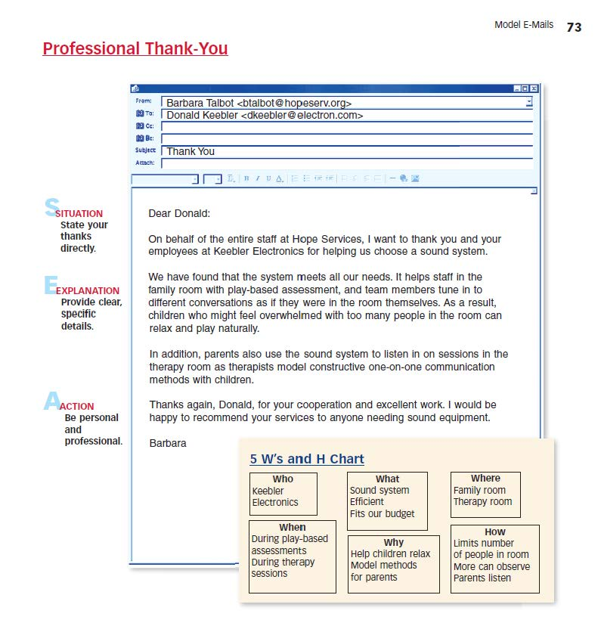
Using Resources
Model your email after the specific forms on pages 71-84.

Slide 7
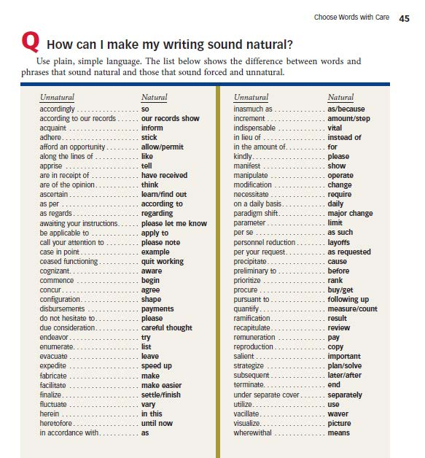
Using Resources
Learn the traits of clear and results-orientated email writing on pages 19-68 of Writing Effective E-Mail.

Slide 8
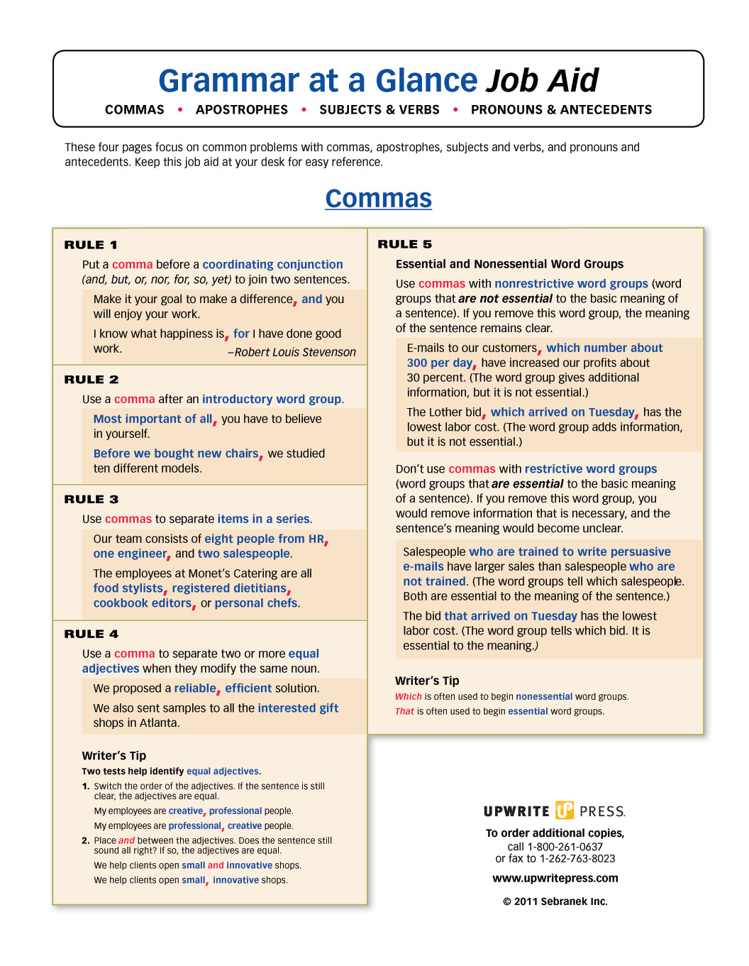
Using Resources
Find key rules in Grammar at a Glance and mark them with a dry-erase pen.

Slide 9
Activity 1: Take a Pre-Assessment

Slide 10
My Goal
To understand the traits that make writing strong and the process for producing writing

Slide 11
Using the Traits and Process
The seven traits of writing can help you understand what makes writing good and how to make it even better.
What are the seven traits of writing?
The seven traits of writing are qualities first identified by Paul Diederich in the 1960s and are supported by 50 years of research:

Slide 12
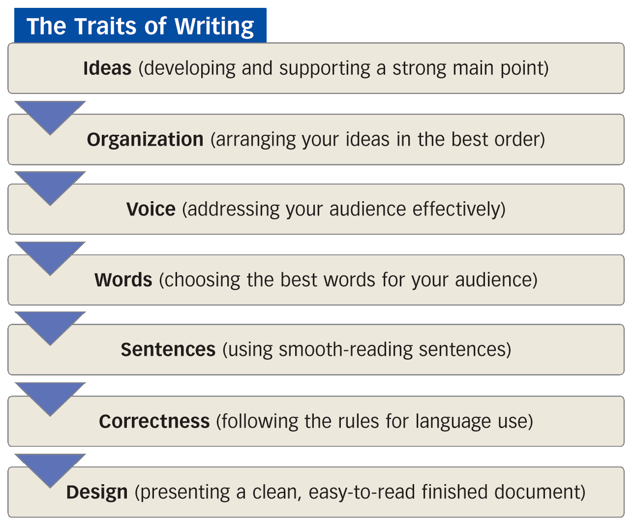
Using the Traits and Process

Slide 13
Using the Traits and Process
What is the writing process?
The writing process is a series of steps that lead you from first thoughts to a finished document. Each step focuses on different traits.

Slide 14
The Writing Process | Traits Focus
Prewriting Think about the purpose, reader, and context. Gather and organize important details. | Ideas Organization
Drafting Create an opening, a middle, and a closing. Organize details in an effective way. | Ideas Organization Voice Words
Revising Clarify your main point and strengthen support. Improve the opening, middle, and closing. Connect with the reader and the topic. | Ideas Organization Voice Words
Refining Check sentences for smoothness and variety. Check punctuation, spelling, and grammar. Use an appropriate format and readable typeface. | Sentences Correctness Design

Slide 15
Activity 2: Reflect on the Traits and the Process

Slide 16
My Goal
To learn about the rules of proper email usage at work

Slide 17
Following Effective Email Policy
Workplace email is more public in nature than you might expect. As a federal employee, your electronic communication may be:
Monitored by your agency.
Treated as an official federal record.
Subjected to release in a court of law.

Slide 18
Following Effective Email Policy
What general usage rules should I follow?
Use fair, respectful language. Take special care in respecting gender, race, religion, ethnicity, age, and people with disabilities.
Use caution with sensitive information. Never send confidential information externally without permission from a manager.
Avoid offensive comments. Do not create or distribute content that is libelous, offensive, defamatory, obscene, threatening, or discriminatory—even in a joking manner.

Slide 19
Following Effective Email Policy
Limit personal use. Clarify your agency’s email policy before using your work email for personal use. Apply the same usage rules from above to personal email.
Never write “angry.” Give yourself time to cool down after an argument or disagreement. Even then, a face-to-face meeting is preferable to email communication.
Respond promptly. Show courtesy by replying to incoming email quickly and thoughtfully. As a general rule, respond to any new message within the business day.

Slide 20
Following Effective Email Policy
Delete all spam and chain letters.
Save messages that are official records. Any federal email that is “made or received in the transaction of agency business” is considered an official record and must be saved. Contact your agency records officers for instructions on how to save and store email messages for recordkeeping.

Slide 21
Following Effective Email Policy
What is my agency’s email policy?
Your agency may have its own specific email policy that you must comply with. If you don’t have a copy of the policy or are unsure of the answers to the questions on the next slide, contact a manager to clarify any uncertainties.

Slide 22
Following Effective Email Policy
What can my workplace email be used for?
How should I manage confidential information using email?
What is considered inappropriate use of workplace email?
To what extent can I use workplace email for personal use?
What right to privacy should I expect regarding workplace email?
What recordkeeping procedure should I follow regarding email?

Slide 23
Activity 3: Follow Effective Email Policy

Slide 24
My Goal
To learn when to use email versus other forms of communication

Slide 25
Managing Email Communication
Not all communication situations call for email. The tips below will help you choose when and when not to use email.

Slide 26
Managing Email Communication
What are my communication options?
You have several options for communicating in the workplace. The graphic on the next slide shows some common forms of workplace correspondence.

Slide 27
Managing Email Communication
Communication Options
Casual, Quick, Personal
Face to Face
Text Message
Phone
Instant Message
Email
Memo
Letter
Report
Formal, Thoughtful
The options at the top of the list are best for minor everyday subjects. They are fast and convenient, and they allow for a quick exchange of ideas. As you move down the list, the options become more formal, requiring more time and thought to create. The options at the very bottom carry the most weight. They are most likely to be published and distributed to a wide audience.

Slide 28
Managing Email Communication
When should I use email?
Email serves many purposes but is not always the best option for workplace communication.

Slide 29
Managing Email Communication
routine business (announcements, meeting notes, questions, project updates)
messages needing wide distribution
global business or business across multiple time zones
electronic documentation
Messages with attachments (documents, reports, etc.)
Use email
for…

Slide 30
Managing Email Communication
Do not use
email for…
serious messages
sensitive messages
confidential information
messages needing an immediate response
private communication

Slide 31
Activity 4: Manage Email Communication

Slide 32
My Goal
To recognize and avoid email pitfalls

Slide 33
Avoiding Email Pitfalls
You can avoid making embarrassing, confusing, or legally problematic mistakes by recognizing and avoiding common email pitfalls.
How can I avoid common email pitfalls?
You don’t have to feel intimidated by email. Here are some simple solutions for avoiding common email mishaps.

Slide 34
Avoiding Email Pitfalls
Problem |  | Solution
Careless grammar, spelling, or punctuation errors |  | Read every message out loud before you send it.
Offensive comments or inappropriate jokes |  | Do not send jokes over workplace email. They may be perceived differently than intended.
The message includes textspeak, such as emoticons or initialisms |  | Do not use textspeak in email. Emoticons and initialisms are unprofessional and can cause confusion
Unnecessary “reply all” Occurs when a user sends a reply to people who do not need it |  | Do not use “reply all” if only the original sender needs to read your message

Slide 35
Avoiding Email Pitfalls
Problem |  | Solution
Forwarding a message without the original sender’s permission |  | When in doubt, get the original sender’s permission before forwarding a message.
Broken email chain Occurs when users send multiple messages back and forth but delete the history of the conversation |  | Include the message thread. Doing so provides context and keeps a helpful record of the digital “conversation.”
Overuse of “Cc” (carbon-copy) Occurs when a user sends a copy of a message to people who do not need it |  | Use “Cc” with caution. Always ask yourself, “Does this person need to know this information?”
Forgotten attachment |  | Upload your attachments first, before drafting your message.

Slide 36
Avoiding Email Pitfalls
Problem |  | Solution
Overuse of capital letters Occurs when entire words are capitalized for emphasis |  | Follow proper capitalization rules. Never write messages in all CAPS, and do not SHOUT words.
Overly long messages |  | As a general rule, if the message doesn’t fit on one screen, summarize it. Issue the remainder of the message in an attachment.
Overuse of “bureaucratese” I hereby do declare . . . Per regards to your query . . . |  | Use plain English, especially for messages intended for an external audience.

Slide 37
Activity 5: Avoid Email Pitfalls

Slide 38
My Goal
To write clear, straightforward messages

Slide 39
Using Plain Language
The Plain Writing Act of 2010 mandates that all writing for the public use plain language.
What should I know about plain language?
The following tips summarize the Federal Plain Language Guidelines. These strategies are taught and applied throughout the course.

Slide 40
Using Plain Language
Organize for clarity. Create an opening, a middle, and a closing, and use an effective plan to arrange details. Use informative headings and lists.

Slide 41
Using Plain Language
Don’t Say | Do Say
Remember, your financial disclosure report must include information on assets and income, liabilities, outside positions, agreements or arrangements, and gifts and travel reimbursements.
Remember, your financial disclosure report must include five parts:
assets and income,
liabilities,
outside positions,
agreements or arrangements, and
gifts and travel reimbursements.

Slide 42
Using Plain Language
Use simple, active verbs. Select verbs that describe the action that the subject of the sentence is doing. Avoid passive verbs for most writing. Don’t use complicated tenses.

Slide 43
Using Plain Language
Don’t Say | Do Say
If the meeting is rescheduled, all attendees should be notified. | If you reschedule the meeting, you should notify all attendees.

Slide 44
Using Plain Language
Use a conversational voice. Write as if you are speaking to a colleague. Choose respectful language, neither overly formal and stuffy nor overly informal and slang ridden. Cut wordiness and unnecessary material.

Slide 45
Using Plain Language
Don’t Say | Do Say
You should be cognizant of the fact that the agency is strategizing advanced modifications to its social media component. | The agency is building a stronger social media presence.

Slide 46
Using Plain Language
Write short paragraphs with topic sentences. Break ideas into digestible chunks, making them easy to read and find again.

Slide 47
Activity 6: Use Plain Language

Slide 48
My Goal
To use respectful email greetings and closings

Slide 49
Writing Respectful Greetings and Closings
Show respect with polite greetings and closings.
Does my email need a salutation or greeting?
Use a polite greeting to begin your message.

Slide 50
Writing Respectful Greetings and Closings
In general, follow these tips:
Use a standard greeting for all formal emails and emails sent to the public.
Examples: Dear Team: Dear Ms. Kendall:
Use a less formal greeting for someone you know well.
Examples: Hello, Jim, Hi, Team,

Slide 51
Writing Respectful Greetings and Closings
Does my email need a closing?
Use a polite closing at the end of an email message, but follow your company’s policy.

Slide 52
Writing Respectful Greetings and Closings
Formal Closings
Use formal closings with all formal messages and messages sent to the public.
Sincerely is the safest choice for both formal and informal messages.
Kind regards is also a safe choice and is preferable to regards, which can come across as cold.
Best wishes is acceptable for work email. Best should be used for informal messages only.
Thank you is appropriate if you are actually thanking the person for something.

Slide 53
Writing Respectful Greetings and Closings
Informal Closings
Informal closings are only acceptable for informal messages sent to close friends and colleagues. Some examples:
Thanks again,
Until next time,
Great speaking with you!

Slide 54
Activity 7: Use Respectful Greetings and Closings

Slide 55
My Goal
To understand the parts of the communication situation

Slide 56
Analyzing Purpose, Reader, and Context
When you prepare to write an email message, think about the purpose, reader, and context.

Slide 57
Analyzing Purpose, Reader, and Context
How do I identify my purpose?
Ask yourself the following questions:
What result do I want?
A clear result is exact, realistic, and measurable.
Do I want to inform my reader?
To inform is to explain, describe, report, outline, or analyze.
Do I want to persuade my reader?
To persuade is to request, convince, apologize, evaluate, or complain.

Slide 58
Analyzing Purpose, Reader, and Context
How do I profile my reader(s)?
Ask yourself the following questions:
What is my relationship with my reader?
Think of the strength of the relationship and the position of the reader.
What does my reader know and need to know?
Match details to a specific reader or a broad audience.
How will my reader react to this message?
Decide how your reader will feel about the message.

Slide 59
Analyzing Purpose, Reader, and Context
How do I profile my reader(s)?
What do I want the reader to do?
Think of the reader’s responsibility and authority.
What secondary readers may view this message?
Imagine who else might read the email.

Slide 60
Analyzing Purpose, Reader, and Context
How do I understand the context?
Ask yourself the following questions:
What is the history of the situation?
What is the current climate of the situation?
What hurdles might block my message?
What time window do I have for sending this message?
What support materials should I send with the message?
How should I follow up with the reader?

Slide 61
Activity 8: Analyze Purpose, Reader, and Context

Slide 62
Lesson 2
Writing Effective Email
Lesson Preview
Writing Your Main Point
Organizing Your Message
Writing Strong Subject Lines
Creating a Positive, Professional Voice
Editing for Correctness
Designing for Clarity

Slide 63
My Goal
To write clear and focused main points

Slide 64
Writing Your Main Point
A well-written email message has two main parts: (1) a main point and (2) supporting details. This page focuses on developing a strong main point.

Slide 65
Writing Your Main Point
How do I focus my message?
State your point clearly and quickly. The message should focus on one main idea. To quickly focus your email ask two questions:
Why am I writing?
The answer to that question is your purpose.
What do I want the reader to know or do?
The answer to that question will be your focus.

Slide 66
Writing Your Main Point
Example
Question: Why am I writing?
Purpose: To request that all non-exempt employees attend a FLSA briefing
Question: What do I want my reader to know or do?
Focus: The FLSA briefing will (1) take place on Friday, November 25. (2) The briefing will discuss important rule revisions for working overtime. (3) All non-exempt employees are required to attend.

Slide 67
Writing Your Main Point
How do I write a focus statement?
Your focus statement is a statement that answers the question, “What do I want my reader to know or do?” It serves as the main idea for your email, and, in most cases, is the first sentence of the message. Use the formula on the next slide to craft your focus statement.

Slide 68
Writing Your Main Point
Focus-statement formula:
A specific topic
+ information or action
= focus statement

Slide 69
Writing Your Main Point
Example 1
All non-exempt employees must attend an FLSA briefing on Friday, November 25, regarding revisions to the rules about working overtime.
Example 2
The department will transition to a new online project-management system effective April 1st.
Example 3
Can you email me a copy of the December 16 Clean Energy Act memo?

Slide 70
Activity 10: Write Strong Main Points

Slide 71
My Goal
To learn about direct and indirect organization and when to use them.

Slide 72
Organizing Your Message
Along with a focus statement, your message may also include additional details that support, or clarify, your main idea. When organizing the details of your email messages, choose between direct or indirect organization.

Slide 73
Organizing Your Message
What are direct and indirect organization?
Direct organization places the main point (focus statement) up front, and indirect organization delays the main point until later.

Slide 74
Organizing Your Message
Direct | Indirect
Opening: | Opening:
Supply context. State the main point. | Get the reader’s attention. Indicate the topic.
Middle: | Middle:
Discuss the main point. Provide supporting points. Arrange details in order. | Give details and analysis. State the main point. Counter objections/offer options.
Closing: | Closing:
Restate the main point. End positively and politely. | Focus on next steps. End politely.

Slide 75
Organizing Your Message
How do I choose between direct and indirect?
Decide whether to use direct or indirect organization based on the reader’s likely response:
Be direct when the reader will be open to your message (good or neutral news).
Be indirect when the reader will be closed to your message (bad news or persuasive pitch). Build up to the point with an explanation or argument.

Slide 76
Organizing Your Message
How can I predict my reader’s response?
Ask yourself the following questions:
What is my relationship with the reader?
What does the reader know and need to know?
How might the reader feel about and react to the message?

Slide 77
Activity 11: Organize Your Message

Slide 78
My Goal
To learn specific strategies for writing different types of emails

Slide 79
Using Organizational Structures
You just learned about the difference between direct and indirect organization. Now you’ll learn about specific structures you can use to organize different types of messages.

Slide 80
Using Organizational Structures
How should I organize good- or neutral-news messages?
If your reader is likely to respond to your message as good or neutral news, be direct. Use the SEA organization formula: Situation + Explanation + Action.

Slide 81
Using Organizational Structures
Situation: Lead with your focus statement
Explanation: Provide specific details relating to the statement.
Action: Focus on future steps and actions the reader should take.
Situation
Explanation
Action

Slide 82
Using Organizational Structures
How should I organize bad-news message?
If your reader may be unhappy or angry with your message, be indirect. Use the BEBE formula: Buffer + Explanation + Bad News + Exit.

Slide 83
Using Organizational Structures
Buffer
Buffer: Start with a statement that offers agreement, understanding, or appreciation.
Explanation: Explain the circumstances.
Bad News: State the bad news (focus statement) factually and calmly.
Exit: Conclude with a statement that is positive but also realistic.
Explanation and Bad News
Exit

Slide 84
Using Organizational Structures
How should I organize persuasive messages?
If your reader may be indifferent or even resistant to your message, be indirect. Use the AIDA formula: Attention + Interest and Desire + Action.

Slide 85
Using Organizational Structures
Attention: Start with a statement that captures the reader’s attention.
Interest and Desire: Build interest and desire by focusing on the benefits of your idea.
Exit: Call the reader to action with your focus statement.
Attention
Interest and Desire
Action

Slide 86
Activity 12: Use SEA, BEBE, and AIDA

Slide 87
My Goal
To write effective subject lines in all my email messages

Slide 88
Writing Strong Subject Lines
The subject line acts as gateway to your message. It is the first thing your readers will see and often determines whether or not they read your message. Strong subject lines convey urgency, indicate action, and summarize the message’s main point.

Slide 89
Writing Strong Subject Lines
What makes an effective subject line?
An effective subject line is . . .
Informative: Make the subject line specific, clear, and precise.
Write: All Divisions’ Quarterly Reports Due April 15
Not: Reports Due
Tip: Make the subject line a mini-summary—or forecast—of your main idea or focus statement.

Slide 90
Writing Strong Subject Lines
Purposeful: Make the subject line signal a specific purpose: to inform, to remind, to call to action, to praise, to request.
Write: Agenda Topics Needed for May 1st Division Meetings
Not: Agenda Topics
Tip: Avoid generalities. Note how the first subject line calls for a specific action from a specific audience, while the second subject line indicates neither a purpose nor a specific audience.

Slide 91
Writing Strong Subject Lines
Positive: State the message’s main point in positive or neutral terms.
Write: 2013 Budget Appropriation Requires Adjustments to 2013 Work Schedules
Not: Prepare for Less Work and Less Pay in 2013
Tip: For serious bad-news messages, use neutral terms in the subject line, open the message with a buffer, and then state the main point—or bad news.

Slide 92
Writing Strong Subject Lines
Relevant: Show readers why the subject is important and how it relates to them.
Write: New Benefit Options Extended to All Employees
Not: Benefit Options
Tip: Readers commonly ignore or delete messages with “say-nothing” subject lines.

Slide 93
Writing Strong Subject Lines
Professional: Use professional, correct language that reflects well on you and your agency. Capitalize the first word, the last word, and all the words in between except articles (e.g., a, an, the), short prepositions (e.g., of, for, over) and short conjunctions (e.g., or, but, and).
Write: Agenda for Committee Meeting on November 10
Not: It’s agenda time!!

Slide 94
Activity 13: Write Strong Subject Lines

Slide 95
My Goal
To establish a positive, professional email writing voice

Slide 96
Creating a Positive, Professional Voice
The best federal email writing sounds positive and professional.

Slide 97
Creating a Positive, Professional Voice
How can I sound more positive?
A positive voice is not only encouraging but also motivating. To establish a positive voice, focus on what can be done, not what can’t.

Slide 98
Creating a Positive, Professional Voice
Focus on . . .
the subject—not on the personalities. Avoid a judgmental tone.
solutions—not on problems.
the future—not on the past. Use the past merely to provide a context for moving forward.
strengths—not on weaknesses.
cooperation—not on antagonism. Move beyond personal attacks.
suggestions—not on threats. Suggestions cultivate new ideas.
positive words—not on negative words.

Slide 99
Creating a Positive, Professional Voice
How can I sound more professional?
A professional writing voice communicates in a straightforward manner. It is not too informal or slangy. At the same time, it is not too formal or stuffy. Strike the right balance by using a conversational writing voice.

Slide 100
Creating a Positive, Professional Voice
Too Formal (Stuffy)
In accordance with the agency material adorning the office walls, it is recommended all employees do their due diligence to follow “zero waste” practices and procedures starting May 15. | Off-putting and pompous voice No contractions or personal pronouns “Million-dollar” words Wordiness Technical terms Long sentences

Slide 101
Creating a Positive, Professional Voice
Just Right (Conversational)
You may have noticed new signs around the office about “Zero Waste Week.” Starting the week of May 15, we are encouraging all agency employees to practice “zero waste” activities. | Direct and inviting voice Some personal pronouns Some contractions Plain language Clear words Varied sentences

Slide 102
Creating a Positive, Professional Voice
Too Informal (Slangy)
See any of those signs around the office ‘bout Zero Waste Week? Go Green by hopping on the “zero waste” bandwagon!! | Unprofessional voice Many personal pronouns Many contractions Jargon, slang, humor Faddish expressions

Slide 103
Activity 14: Create a Positive, Professional Voice

Slide 104
My Goal
To edit my email messages for correctness

Slide 105
Editing for Correctness
You can avoid careless writing mistakes by editing your email messages. Editing involves closely reading and rereading your messages for errors in spelling, grammar, and punctuation.

Slide 106
Editing for Correctness
What reading strategies can help me edit my email?
You can identify writing errors by reading and rereading your message. Follow these steps:
Read your message out loud. Hearing your email out loud will help you pick out mistakes that you might otherwise miss by reading silently.
Reread your message backwards. Start at the end of your message. Read backwards, using an editing checklist (see below) to look for incorrect grammar and punctuation. This strategy is recommended by professional proofreaders.

Slide 107
Editing for Correctness
How can I use an editing checklist?
You can use a checklist to guide your editing. Check each item on the list. For further help, consult your Grammar at a Glance Job-Aid or the Writing Effective E-Mail pages shown in parentheses.

Slide 108
Editing for Correctness
Editing Checklist
Sentences
Do all of my sentences express a complete thought? (page 48)
Do all of my sentences have a subject and a verb? (page 48)
Do my subjects and verbs agree in number? (page 56)

Slide 109
Editing for Correctness
Editing Checklist
Sentences
Are my verbs active and simple in tense? (page 48)
Have I avoided slang and double negatives?

Slide 110
Editing for Correctness
Editing Checklist
Correctness
Does each sentence end with correct punctuation?
Do commas set off introductory clauses and phrases? (page 54)
Do commas separate items in a series? (page 54)

Slide 111
Editing for Correctness
Editing Checklist
Correctness
Are all first words and proper nouns capitalized?
Are formal titles before names capitalized?
Have I correctly formed plurals? (page 59)

Slide 112
Editing for Correctness
Editing Checklist
Correctness
Have I checked my spelling and double-checked names?
Have I avoided textspeak (emoticons and initialisms)?

Slide 113
Activity 15: Edit for Correctness

Slide 114
My Goal
To use effective design elements that enhance my email messages

Slide 115
Designing for Clarity
A well-designed email message is easy to read and understand. It clearly communicates a message and avoids distracting design elements.

Slide 116
Designing for Clarity
What design elements should I follow?
For all messages, use these design elements appropriately.

Slide 117
Designing for Clarity
Font
Select a readable font (10-12 point).
Readable serif font: Times New Roman, Georgia, or Minion Pro.
Readable sans serif font (preferable for email): Helvetica or Arial.
*This PowerPoint presentation uses an Arial font.

Slide 118
Designing for Clarity
Paragraphs
Use short paragraphs and double space between them. Most paragraphs should not exceed eight lines.

Slide 119
Designing for Clarity
Lists
If a main idea has several specific details, list them for easy reading. If order is important, use a numbered list (1, 2, 3, etc.). If the order is not important, use bullets. A list may be displayed outright or integrated.

Slide 120
Designing for Clarity
Displayed List
Create a displayed list (as shown in this explanation) by doing the following:
Identifying all items in the list.
Introducing each item with a symbol.
Constructing all items in a parallel form.

Slide 121
Designing for Clarity
Integrated List
Create an integrated list (shown here) by (1) placing the numbers in parenthesis, (2) integrating list items in a sentence or paragraph, and (3) constructing all items in parallel form.

Slide 122
Designing for Clarity
Headings
Use headings to distinguish main points or message segments. Headings are especially important for longer messages.

Slide 123
Designing for Clarity
White Space
Effective use of white space helps “lift” ideas off the page by breaking text into readable units. Use white space between new paragraphs.

Slide 124
Designing for Clarity
Attachments
For messages that are long (multi-screen) or contain graphics, use attachments. Anytime you include an attachment:
Inform your reader that a file is attached and explain what the person should do with it.
Compress large files with a compression program.
Limit the number of files to two or three per message.

Slide 125
Activity 16: Assess Email Design

Slide 126
My Goal
To create a personal contract to ensure my learning

Slide 127
Applying Your Learning
You’ve put forth great effort and learned a lot. Now you are ready to apply the skills from this course back on the job. By creating a personal contract, you can explain how you will apply what you’ve learned.
How can I create a personal contract?
You can create a personal contract by setting a few goals and outlining specifically what you will do to reach them. Here is a sample personal contract.

Slide 128
Applying Your Learning
How can I create a personal contract?

Slide 129
Activity 17: Create a Contract

Slide 130
Activity 18: Take a Post-Assessment

