Slide 2

Table of Contents
Lesson 1
Lesson 2
Lesson 3
Lesson 4
Click here to return to previous slide.

Slide 3
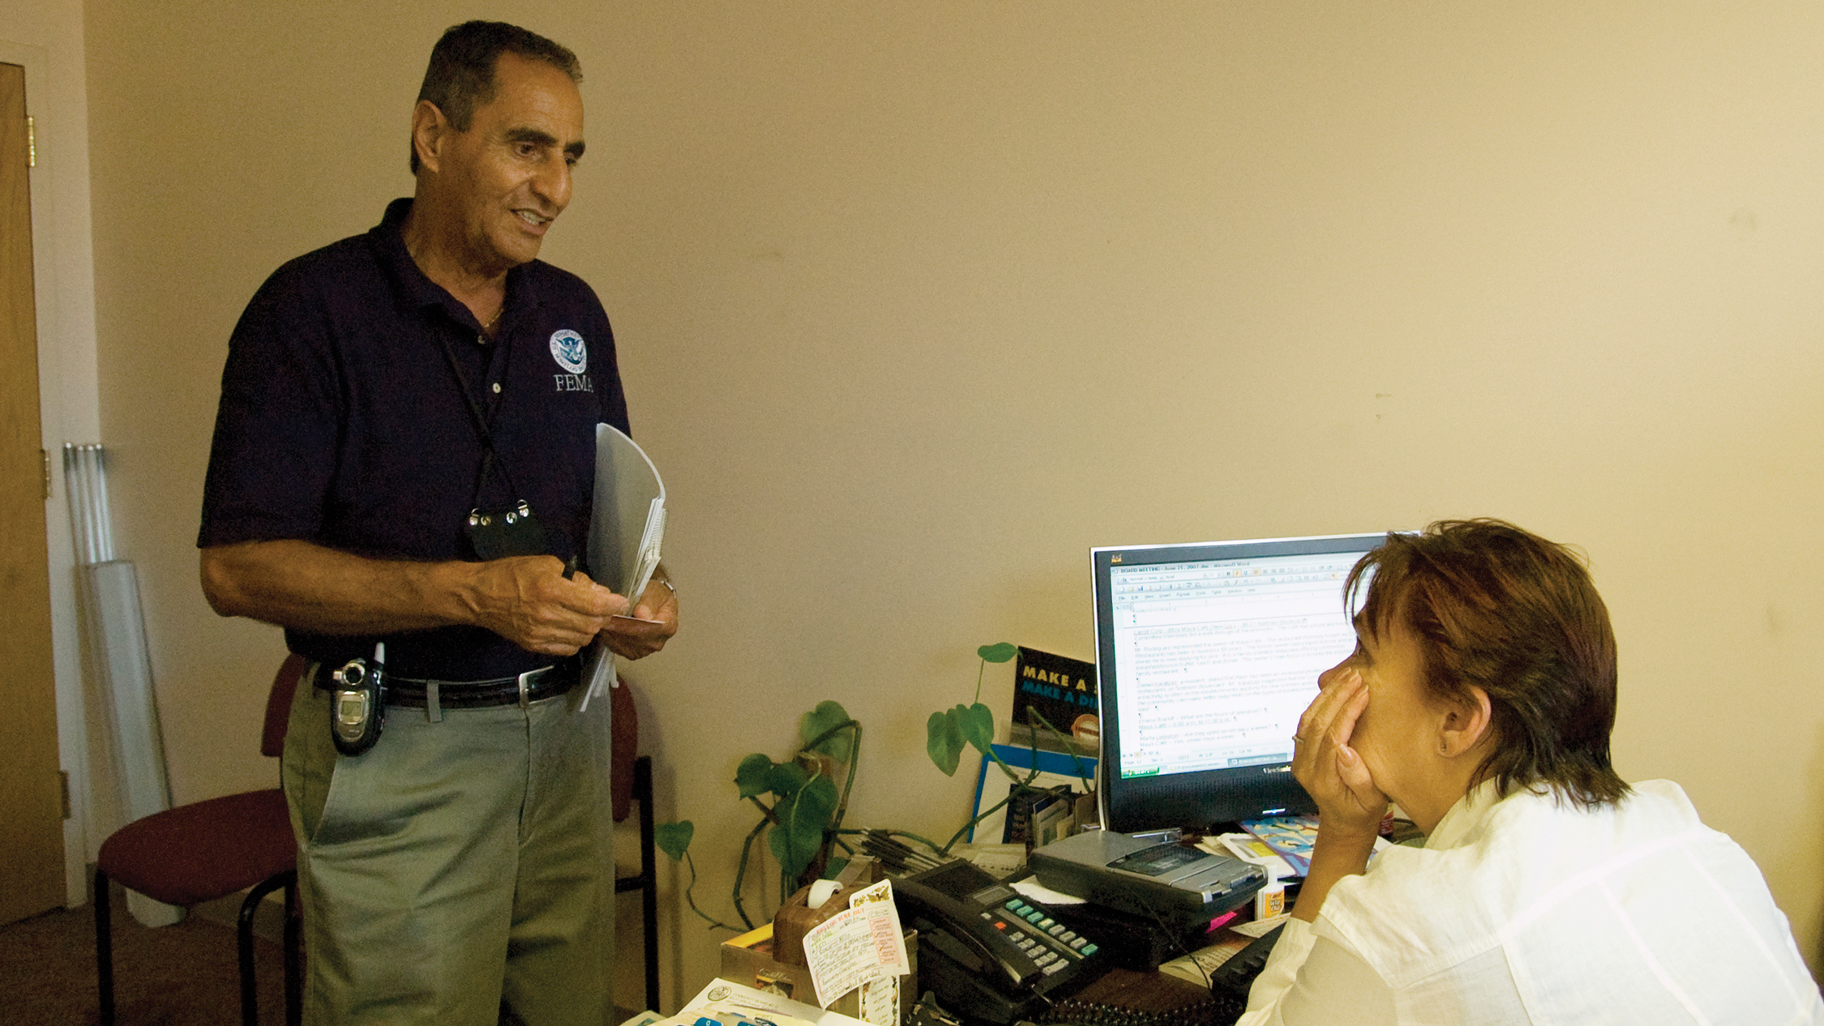
Lesson 1
Defining and Solving
Workplace Problems
Lesson Preview
    Using Your Resources
    Understanding Problem Solving
    Thinking Critically
    Targeting Causes and Effects
    Using Root Cause Analysis
    Brainstorming Ideas
    Blending Concepts

Slide 4
My Goal
To understand the resources that help me solve problems

Slide 5
Using Your Resources
How should I use the resources
I have?
Your participant guide contains the practical tools and practice that will help you solve problems at work and away from the job. This material is designed to guide you during the session and also back at your desk.
Lesson 1

Slide 6
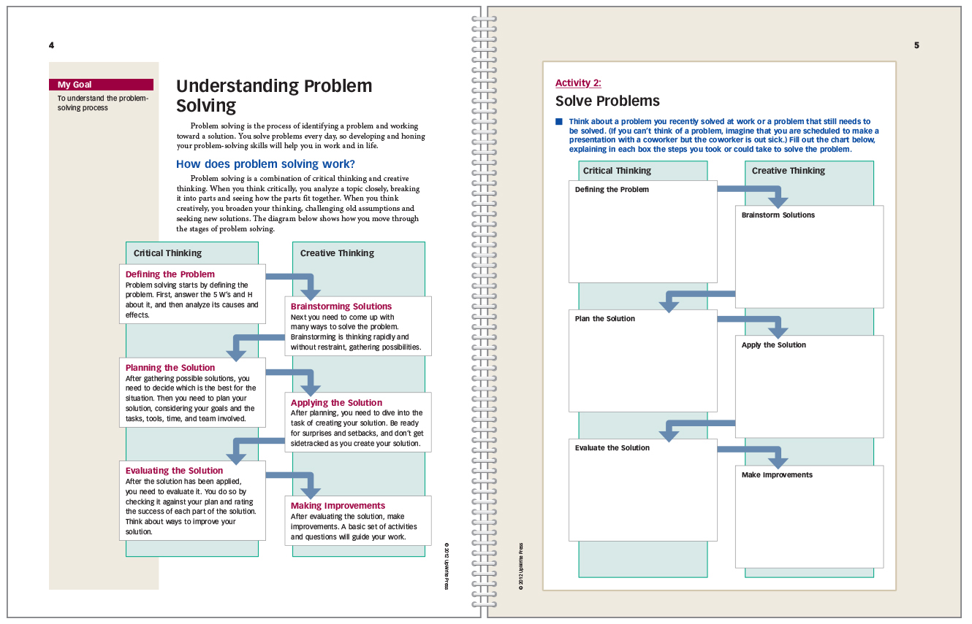
Using Your Resources
Left-hand pages contain instructions and examples.
Right-hand pages contain activities.

Slide 7
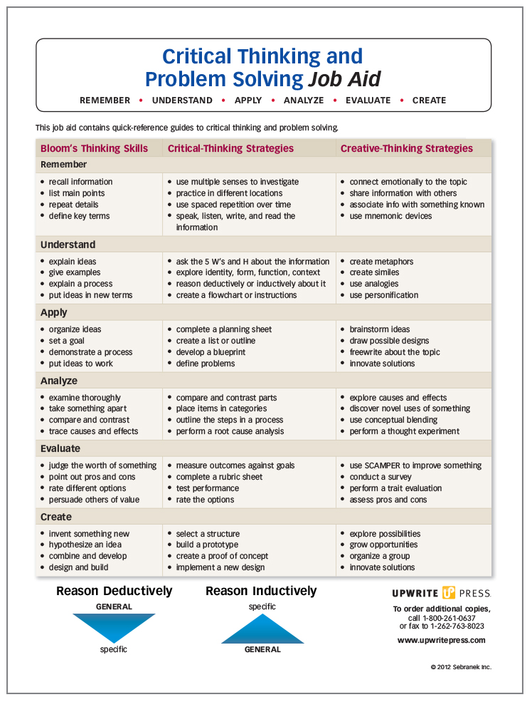
Using Your Resources
The Job Aid puts problem-solving strategies at your fingertips.

Slide 8
Activity 1:
Taking a Pre-Assessment

Slide 9
My Goal
To understand the problem-solving process

Slide 10
Understanding Problem Solving
Problem solving is the process of identifying a problem and working toward a solution. You solve problems every day, so developing and honing your problem-solving skills will help you in work and in life.

Slide 11
Understanding Problem Solving
How does problem solving work?
Problem solving is a combination of critical thinking and creative thinking. When you think critically, you analyze a topic closely, breaking it into parts and seeing how the parts fit together. When you think creatively, you broaden your thinking, challenging old assumptions and seeking new solutions. The diagram below shows how you move through the stages of problem solving.

Slide 12
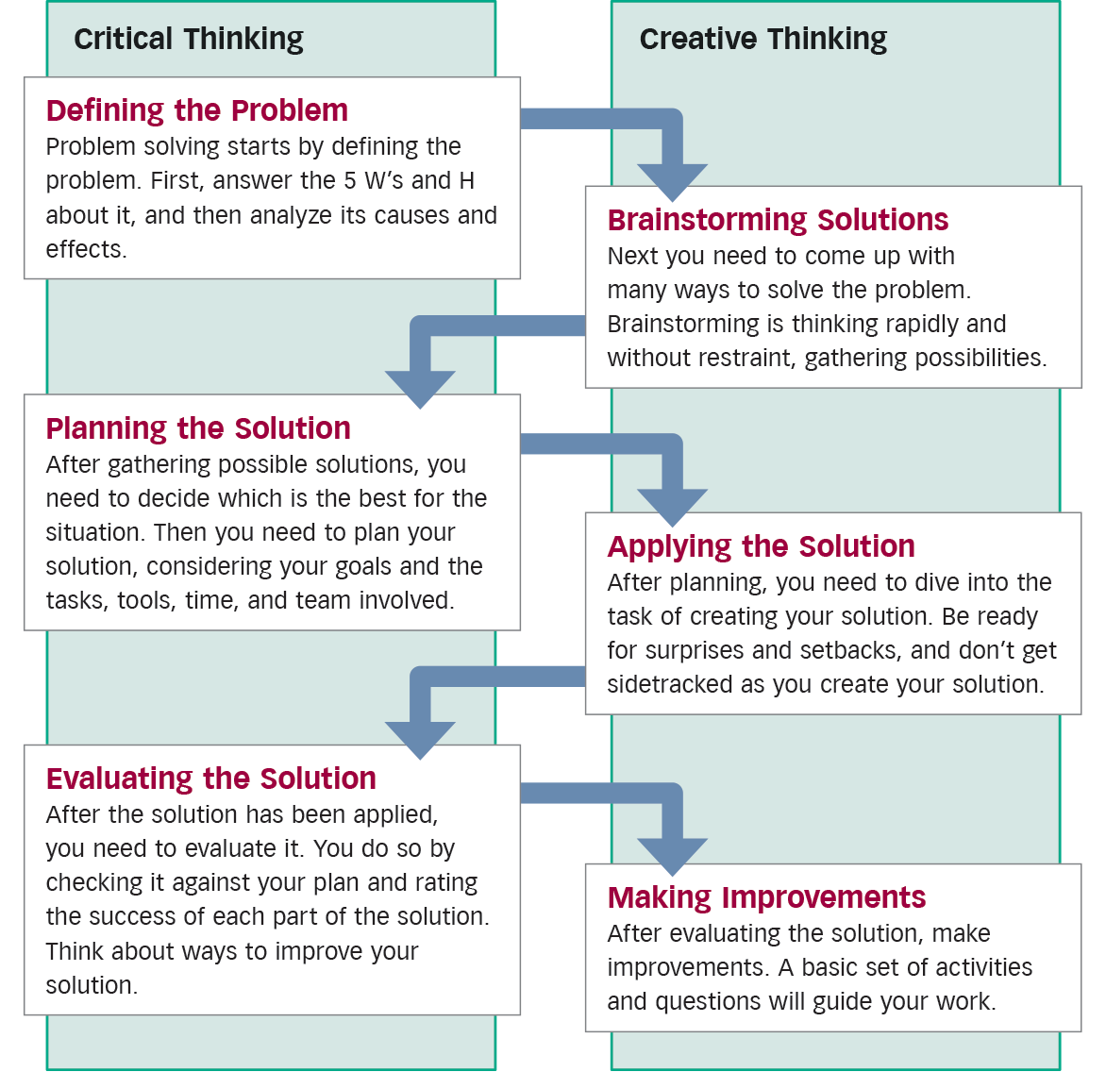

Slide 13
Activity 2:
Solve Problems

Slide 14
My Goal
To understand and use different levels of critical thinking

Slide 15
Thinking Critically
Critical thinking is close, careful thinking. It delves deeply into a topic, separating it into pieces and studying how those pieces fit together. The cognitive abilities involved in critical thinking will help you make a precise assessment of any problem.

Slide 16
Thinking Critically
What thinking abilities should I have?
Researcher Benjamin Bloom developed the following list of thinking skills that progress to ever-deeper levels of thought. Following the progression of thinking will strengthen your ability to identify and assess the root of any problem. Here is a revised version of Bloom’s Taxonomy of thinking.

Slide 17
Thinking Critically
What thinking abilities should
I have?
Remember
recall information
list main points
repeat details
define key terms
Key Words
circle
define
identify
label
list
match
name
recall
DEEPER THINKING
Understand
explain ideas
give examples
explain a process
put ideas in new terms
Key Words
cite
describe
explain
recount
report
review
reword
tell

Slide 18
Thinking Critically
What thinking abilities should
I have?
Apply
organize ideas
set a goal
demonstrate a process
put ideas to work
Key Words
change
demonstrate
do
illustrate
locate
model
organize
show
DEEPER THINKING
Analyze
examine thoroughly
take something apart
compare and contrast
trace causes and effects
Key Words
break down
classify
compare
connect
contrast
examine
map
show why

Slide 19
Thinking Critically
What thinking abilities should
I have?
Evaluate
judge the worth of something
point out pros and cons
rate different options
persuade others of value
Key Words
argue
assess
convince
critique
judge
persuade
rate
recommend
DEEPER THINKING
Create
invent something new
hypothesize an idea
combine and develop
design and build
Key Words
break down
classify
compare
connect
develop
imagine
invent
synthesize

Slide 20
Activity 3:
Think Critically

Slide 21
My Goal
To understand and analyze the causes and effects of a problem

Slide 22
Targeting Causes
and Effects
Problem solving starts by defining the problem. To do so, you need to take stock of the problem and analyze its causes and effects.

Slide 23
Targeting Causes
and Effects
How can I understand the problem?
You can understand a problem by asking journalistic questions about it. The 5 W’s and H will help you define the problem so that you can analyze it and discover a solution.

Slide 24
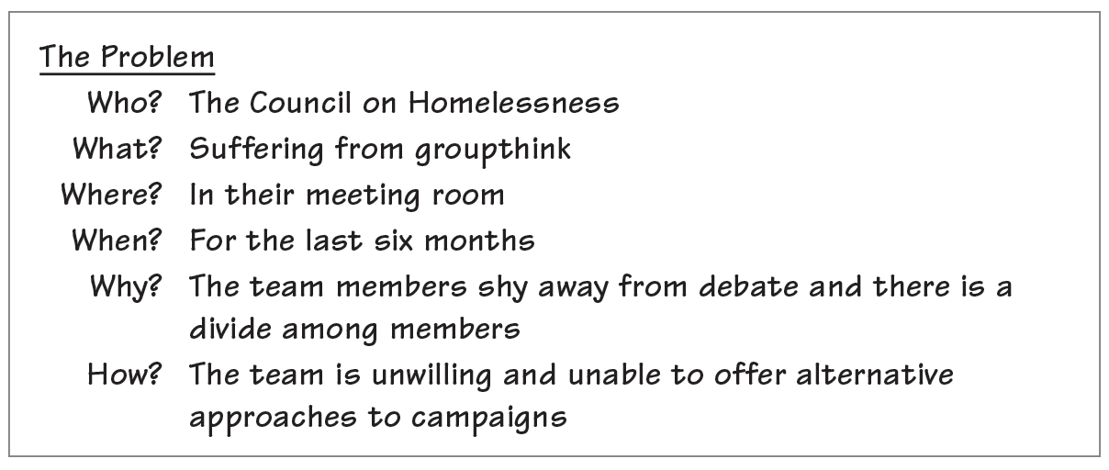
Targeting Causes
and Effects
How can I understand the problem?

Slide 25
Targeting Causes
and Effects
How can I analyze the problem’s causes and effects?
A cause-effect chart helps you closely analyze the problem, looking at reasons it exists and the issue or issues that result from it. Knowing the causes and effects of a problem will help you devise an effective solution.

Slide 26
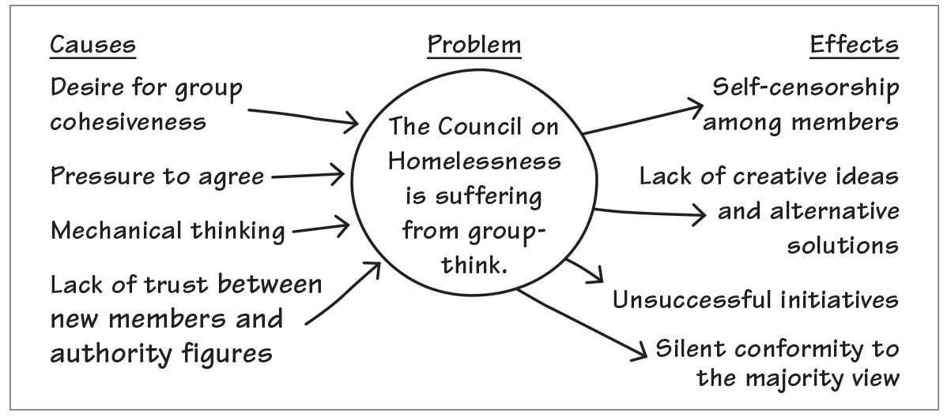
Targeting Causes
and Effects
How can I analyze the problem’s causes and effects?

Slide 27
Targeting Causes
and Effects
What do I do next?
After exploring the causes and effects of the problem, you can begin to think of ways to eliminate causes and effects.
Desire for cohesiveness: How else could we improve camaraderie?
Pressure to agree: How can we make it a priority to air objections or doubts?

Slide 28
Targeting Causes
and Effects
What do I do next?
Mechanical thinking: Could we think more critically using Bloom’s Taxonomy?
Lack of trust: How can we make assigning tasks neutral?
Self-censorship: How can we make all members feel more comfortable offering their opinions?

Slide 29
Activity 4:
Target Causes and Effects

Slide 30
My Goal
To understand the basics of root cause analysis

Slide 31
Using Root Cause Analysis
Agencies like the Nuclear Regulatory Commission use root cause analysis, a rigorous approach to defining problems.
How does root cause analysis work?
Root cause analysis is usually performed by a team investigating a negative event that has occurred or could occur in the future. The team systematically searches for multiple causes, asking questions like the following:

Slide 32
Using Root Cause Analysis
How does root cause analysis work?
What caused an event’s . . .
nature? (What exactly occurred?)
magnitude? (How large was the problem?)
location? (Where did it occur, and what surrounds this location?)
timing? (When did it occur, and what came before and after?)

Slide 33
Using Root Cause Analysis
How does root cause analysis work?
This analysis leads to constructing a timeline listing all of the things that happened leading up to the event and all the things that should have happened to prevent the event from occurring.

Slide 34
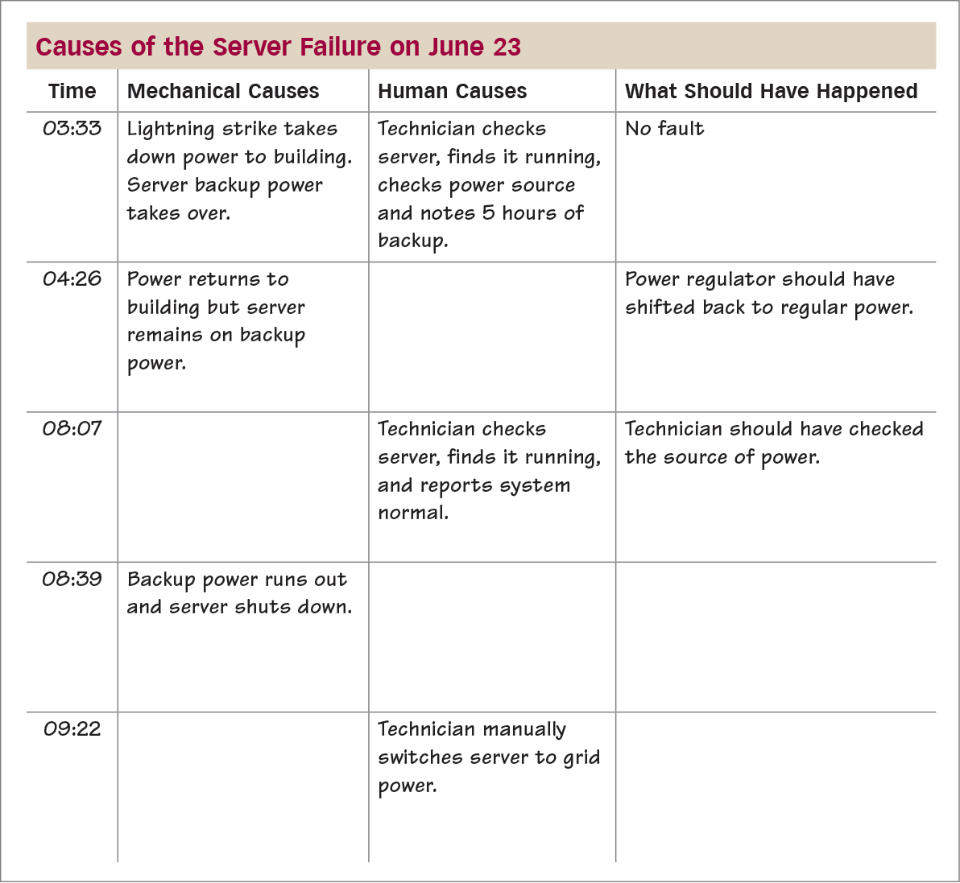
Using Root Cause Analysis
How does root cause analysis work?

Slide 35
Activity 5:
Use Root Cause Analysis

Slide 36
My Goal
To use brainstorming to discover possible solutions

Slide 37
Brainstorming Ideas
Brainstorming is a process of rapidly coming up with as many possibilities and connections as you can. Brainstorming works best in a group because of the many differing perspectives, but you can also brainstorm on your own.

Slide 38
Brainstorming Ideas
How does brainstorming work?
Brainstorming starts with a question or topic and leads to as many answers or connections as possible. Write down every answer without judging—even wild ideas. Judging ideas shuts off the creative flow. Record your brainstorming by writing the question or topic at the top and listing answers or connections
below it:

Slide 39
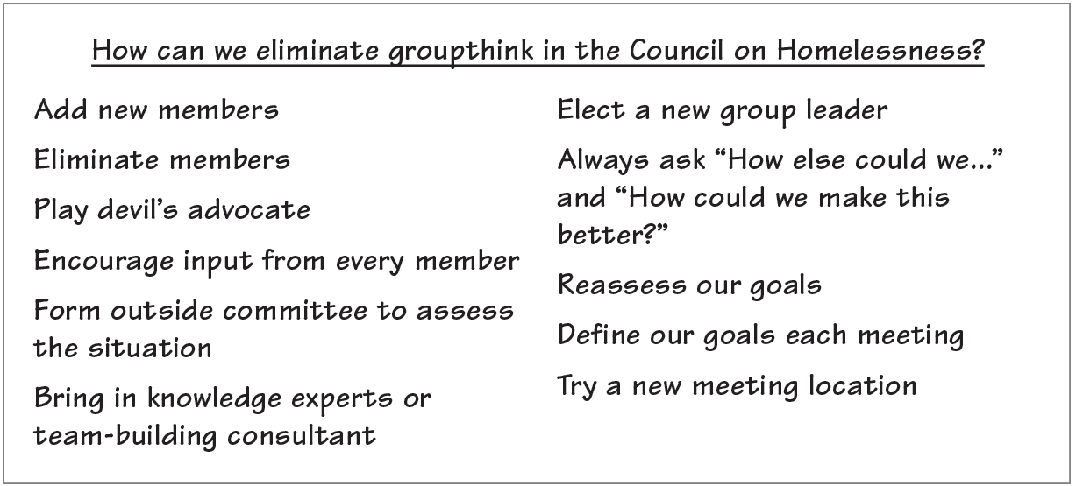
Brainstorming Ideas
How does brainstorming work?

Slide 40
Brainstorming Ideas
How does brainstorming work?
You can also record brainstorming on a map, or cluster. Write the question in the center and circle it; then write answers all around it. A mind map can encourage creativity.

Slide 41
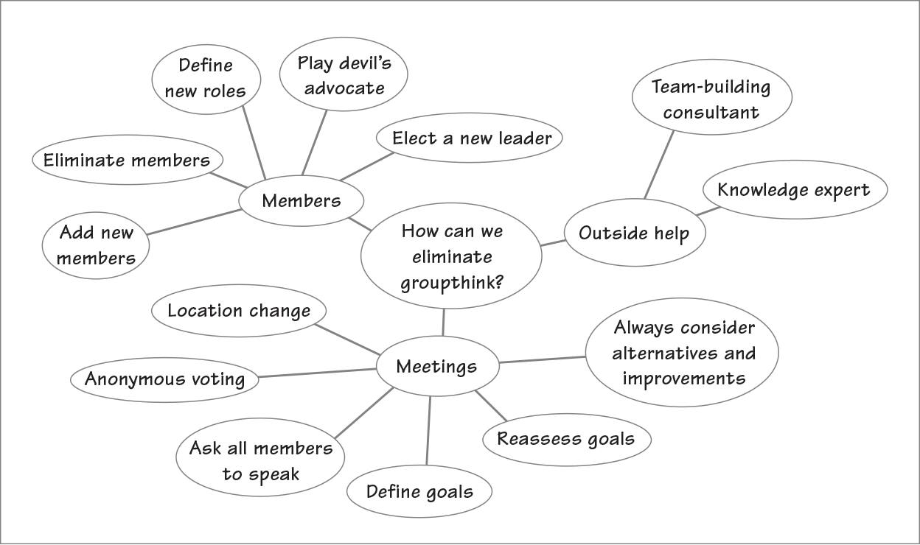
Brainstorming Ideas
How does brainstorming work?

Slide 42
Activity 6:
Brainstorm Solutions

Slide 43
My Goal
To learn how to blend concepts together to come to new understandings

Slide 44
Blending Concepts
Conceptual blending is the antithesis of mechanical thinking. It is a creative-thinking technique that forces you to blend two unrelated concepts together and work out the conflicts between them. The forced connection can produce new ideas that you never would have made through conventional thinking.

Slide 45
Blending Concepts
How does conceptual blending work?
Conceptual blending works by taking two dissimilar things, asking how they work together, and analyzing their connections. You can use conceptual blending to discover new solutions to problems.

Slide 46
Blending Concepts
How does conceptual blending work?
How can our committee be more like a successful sports team?
Every member should understand his or her role.
There should be great leadership.
The group should have a defined goal.
The members should be dedicated to achieving that goal.
Members should maximize each other’s strengths and minimize each other’s weaknesses.
The members should execute a game plan.
Members should continue to learn and perfect their craft.

Slide 47
Blending Concepts
How does conceptual blending work?
What could a PowerPoint presentation learn from a documentary film?
The subject needs to be relevant.
The opening needs to grab the audience’s attention.
There should be some arresting visuals.
The voices and language need to sound natural.
The transitions between scenes (slides) need to be seamless.
Additional perspectives about the topic make the presentation balanced and informative.
One person shouldn’t be talking the whole time.
The ending needs to include a call to action.

Slide 48
Blending Concepts
How does conceptual blending work?
What qualities should an office share with a well-run restaurant?
The atmosphere should be inviting.
The customer service should be friendly and helpful.
The product and work flow should be efficient.
The seating should be conducive to communication.
Proper tools and updated technology should be available to do the job right.
The outflow should serve the customers’ needs and interests.

Slide 49
Activity 7:
Blend Concepts

Slide 50
Activity 8:
Lesson Wrap-Up

Slide 51

Lesson 2
Innovating Solutions at Work
Lesson Preview
    Evaluating Possible Solutions
    Planning Your Solution
    Creating Prototypes
    Presenting to Stakeholders
    Creating Your Solution
    Improving Your Solution

Slide 52
My Goal
To gain a powerful tool for evaluating options

Slide 53
Evaluating Possible Solutions
Once you have used brainstorming and conceptual blending to discover many possible solutions, you’ll need to select your best options and evaluate them.

Slide 54
Evaluating Possible Solutions
How can I evaluate solutions?
You can create a trait-evaluation chart like the one below. In the left-hand column, list the key traits of your solution. Then in each of the other columns, list one of your options. Finally, rate each option for each trait, using a scale like the one below the chart. (This example compares three possible secure-entry solutions.)

Slide 55
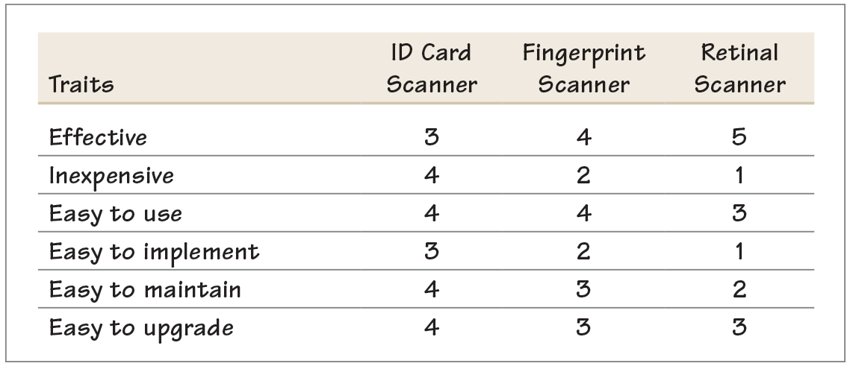
Evaluating Possible Solutions
How can I evaluate solutions?
Not at All Slightly Somewhat Mostly Completely
1 2 3 4 5

Slide 56
Evaluating Possible Solutions
How do I use this evaluation?
A trait evaluation allows you to compare options trait by trait or as a whole. In the example above, if the most important trait to the new access security system is that it be effective at preventing unauthorized access, clearly the retinal scanner beats out the other options. However, if cost is the major factor, the retinal scanner is the worst option. And if all traits are relatively even in importance, you can add up the total score to see which option provides the best value:

Slide 57
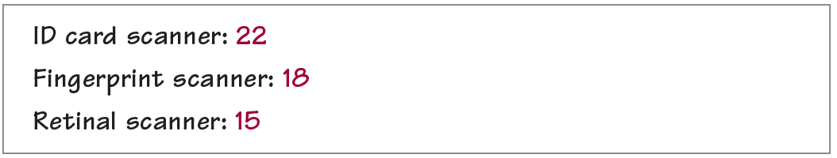
Evaluating Possible Solutions
How do I use this evaluation?

Slide 58
Evaluating Possible Solutions
How does this evaluation help
with buy-in?
A trait evaluation helps you get buy-in from stakeholders in a number of ways:
It can be completed by a whole group, getting buy-in from members.
It identifies and quantifies desired traits for stakeholders.
It allows a clear comparison based on numerous traits.
It establishes a reason for a choice as well as expectations for the choice.

Slide 59
Activity 9:
Evaluate Solutions

Slide 60
My Goal
To learn strategies for planning solutions

Slide 61
Planning Your Solution
So, you’ve selected the solution that seems most promising, given your situation. Now it’s time to plan how you will implement the solution.

Slide 62
Planning Your Solution
How can I plan my solution?
You can plan a solution by filling out a planning sheet like the one below. First, write down your goal, which identifies the problem and your solution. Then answer the 5 W’s and H about your solution. Afterward, consider the 4 T’s: tasks, time, team, and tools. When you finish your plan, apply your solution.

Slide 63
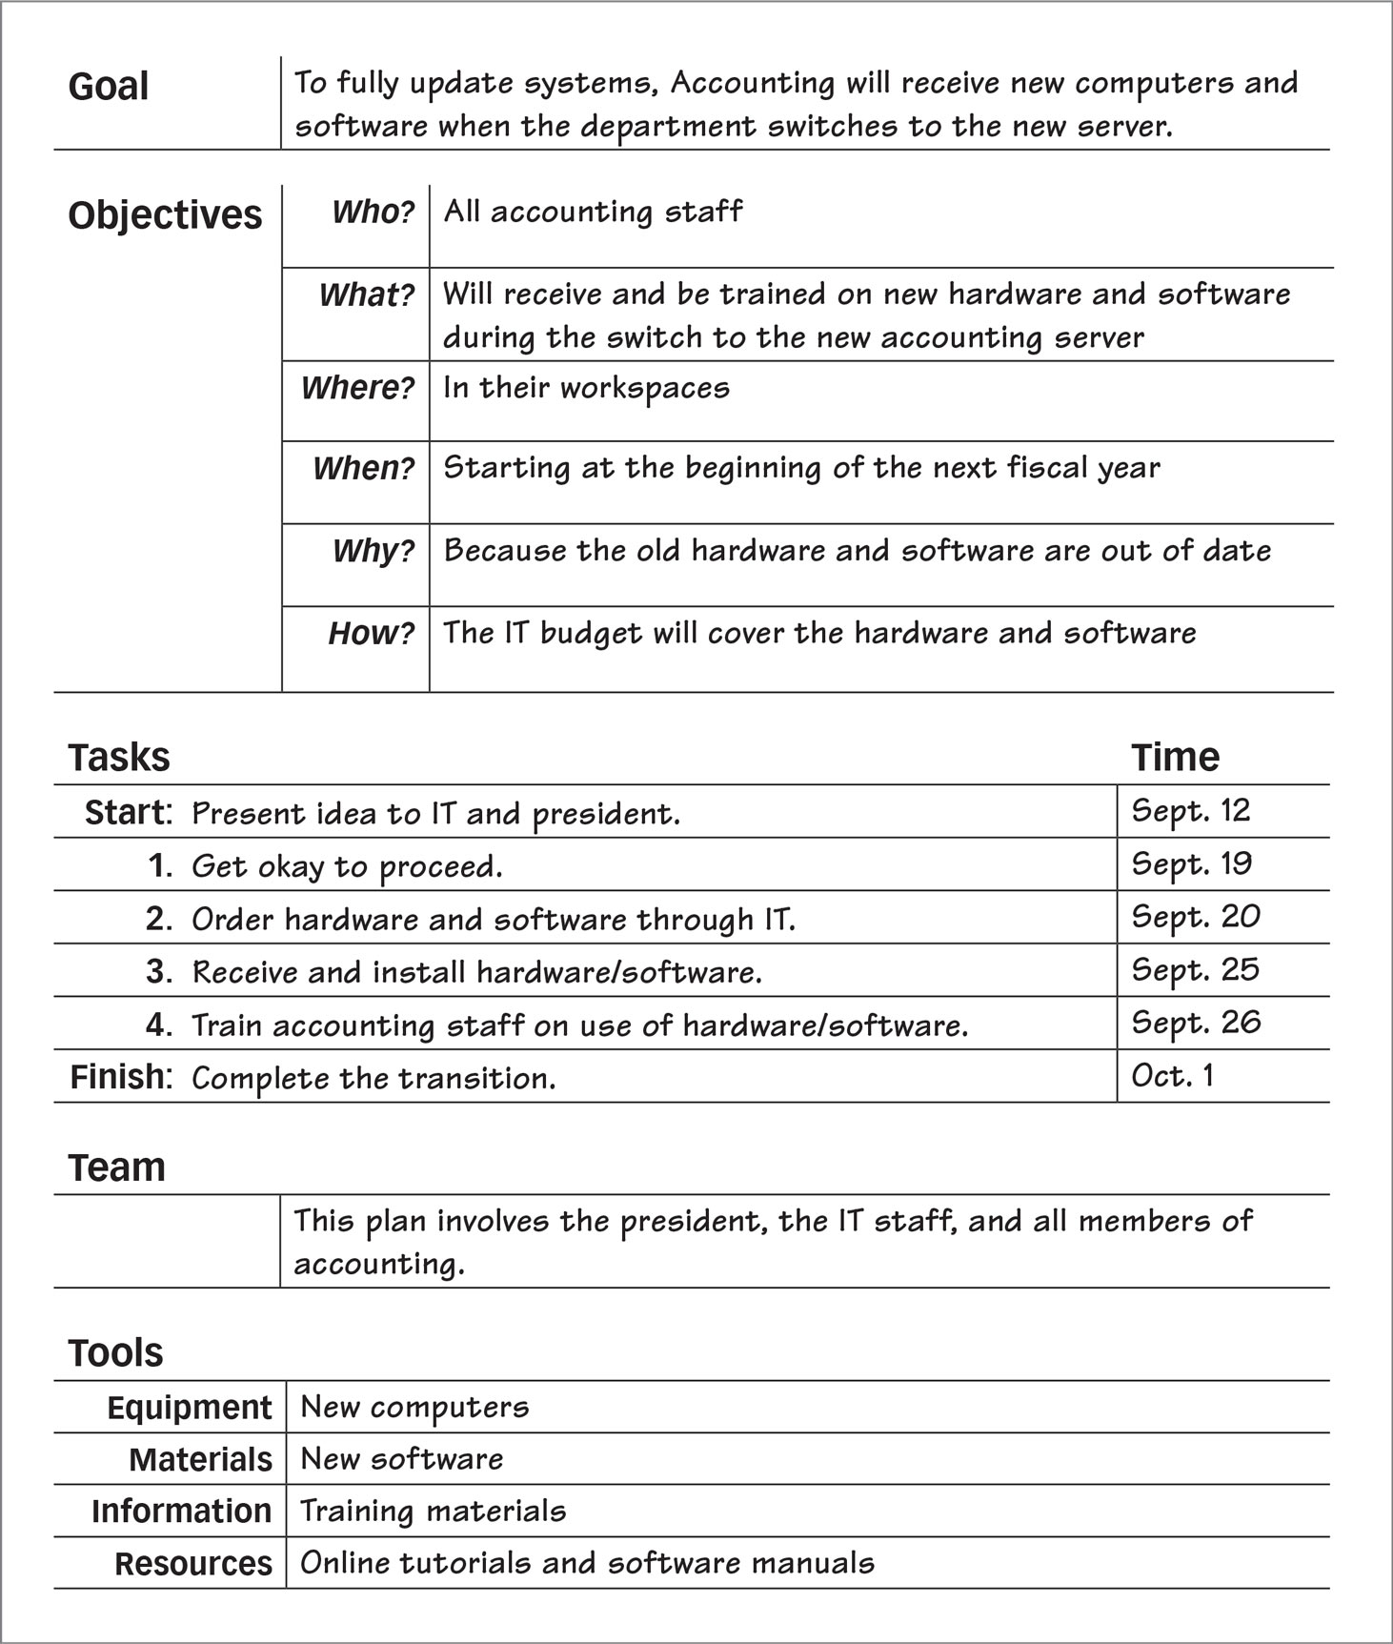
Planning Your Solution
Planning
Sheet

Slide 64
Activity 10:
Plan the Solution

Slide 65
My Goal
To understand the process of creating a prototype

Slide 66
Creating Prototypes
Some solutions are big. They require a lot of time, labor, and feedback from stakeholders. For such solutions, it’s critical that you “fail early and often”—when failure is cheap. Creating a prototype allows you to experiment with your solution while it is still quick and cheap.

Slide 67
Creating Prototypes
What is a prototype?
A prototype is an early version of your solution that you can test out in a real-world setting. An effective prototype . . .
is quick and cheap to make,
tests key features of your solution,
prompts analysis of components,
spurs thinking about alternatives,
facilitates design thinking,
allows feedback from designers and stakeholders,
gets buy-in from designers and stakeholders,
is easy to modify,
is easy to throw out and start over,
is a concrete form of thinking that allows deeper thinking, and
helps designers answer key questions before moving to more complex, complete, and costly forms of the solution.

Slide 68
Creating Prototypes
Why create a prototype?
Different prototypes have different purposes. Some prototypes are primarily experiments to see what will work. Others are meant to communicate an idea to other creators. Often, prototypes are meant to get buy-in from key stakeholders, a process you’ll explore on pages 26-27. The most powerful prototypes, of course, perform multiple roles.

Slide 69
Creating Prototypes
What forms can prototypes take?
The forms of prototypes are dictated by the final product. Plan to prototype each part of a solution that you are uncertain about:

Slide 70
Creating Prototypes
What forms can prototypes take?
Process prototypes: proposal, instructions, new procedure, new work flow
Product prototypes: Proposal, concept sketches, rapid prototype, proof of concept, scale model, working prototype
Building prototypes: Proposal, artist’s rendering, elevations, floor plans, scale model, technical rendering

Slide 71
Creating Prototypes
What forms can prototypes take?
Software prototypes: Proposal, flowchart, wire frame, horizontal prototype, vertical prototype, initial build, beta
Writing-project prototypes: Proposal, table of contents, outline, sample chapters, design prototype, sampler, first draft

Slide 72
Activity 11:
Consider Prototypes

Slide 73
My Goal
To learn strategies for getting stakeholder buy-in

Slide 74
Presenting to Stakeholders
Stakeholders are those who are going to be affected by the solution and often are those paying to have the solution created. A key part of complex problem solving is to get feedback and buy-in (approval to complete the solution) from key stakeholders.

Slide 75
Presenting to Stakeholders
How can I get stakeholder buy-in?
Use your prototypes as opportunities to communicate with and get approval from stakeholders. Remember that stakeholders may be resistant to changes, so the way you present your prototype is critical for overcoming this resistance and getting buy-in. Follow these tips:

Slide 76
Presenting to Stakeholders
How can I get stakeholder buy-in?
Remind the stakeholders of the goal and objectives.
“The goal here is to take some unused warehouse space and convert it into a workspace that can accommodate the IT department, which includes 12 workers, their desks and equipment, and the servers.”
Indicate what the prototype is meant to do and what it is not meant to do.
“These are early concept sketches that show possible layouts for the converted office space. As you can see, we’ve experimented with three different arrangements.”

Slide 77
Presenting to Stakeholders
How can I get stakeholder buy-in?
Indicate just what feedback you want and do not want for a given prototype.
“Specifically, I’d like you to focus on the choices for cubical boundaries—four-foot, five-foot, cloth, glass, or open. Don’t worry about the lighting shown here. We’ll show you a number of possibilities for lighting later.”

Slide 78
Presenting to Stakeholders
How can I get stakeholder buy-in?
Record the feedback, thinking about what is working and what could work better. Also consider other improvements that you could make based on the feedback.
“So, it sounds like you are really much more interested in keeping an open concept. Should that idea extend beyond the workspaces? For example, if we introduced a bank of skylights, that would make the space feel much more open.”

Slide 79
Presenting to Stakeholders
How can I get stakeholder buy-in?
Choose your battles, keeping your eyes on the goal. As long as you and the stakeholders share a common goal, you can agree to adopt changes that serve that goal and reject changes that do not.
“We need to remember that this space must accommodate the servers, which will need to be separated from the open space and have their own climate controls.”

Slide 80
Activity 12:
Get Buy-In

Slide 81
My Goal
To understand three basic approaches to creating solutions and recognize when each approach works best

Slide 82
Creating Your Solution
Creating your solution is a matter of working with your plan, your prototypes, and the feedback you have received in order to actualize your solution. Different types of solutions require different approaches.

Slide 83
Creating Your Solution
What are three approaches to creating?
There are three basic approaches to creating something: building, growing, and exploring. The best approach depends on the situation and the person who is doing the work. At times you’ll use all three approaches.

Slide 84
Creating Your Solution
What are three approaches to creating?
Ways to Create | Description | Best Use | Caveat | Example
Building | When you build something, you start with critical thinking. You set precise goals, make careful plans, gather the materials you need, and work steadily at creating. | This approach works best when materials are expensive, schedules are tight, and results are well defined. | When building something, don’t be ruled solely by your plans. Be ready to take opportunities that arise. | A social worker logs a summary report after a client consultation. The report has clearly defined parts and requires timely completion.

Slide 85
Creating Your Solution
What are three approaches to creating?
Ways to Create | Description | Best Use | Caveat | Example
Growing | When you grow something, you use critical thinking and creative thinking hand in hand. You have a plan, but you also watch things develop and adapt as you go. | This approach works best when factors aren’t completely within your control and some unknowns exist. | When growing something, you need to constantly tend your project and react as it changes. | A social worker sets out to establish trust with a new client. The worker has a plan but must react to the client’s uncertain state of mind

Slide 86
Creating Your Solution
What are three approaches to creating?
Ways to Create | Description | Best Use | Caveat | Example
Exploring | When you explore something, you lead with your creative thinking. You set off with a minimal plan and the desire to discover, react, and improvise. | This approach works well when the results are unknown, time is abundant, and materials are cheap. | When exploring, you must dynamically adapt to an ever-changing situation. Be ready for waste and trimming. | A social worker creates new trust-building activities and then tests them out on a co-worker.

Slide 87
Creating Your Solution
How should I use the ways to create?
Decide on building, growing, or exploring as the situation dictates. For more complex solutions, you’ll do all three. For example, if you are tasked with writing a manual for new employees who will do the same job that you do, you might first write procedures for individual tasks you perform (exploring), then arrange the procedures in a logical order (building), and then add whatever you need to fill in the gaps (growing).

Slide 88
Activity 13:
Create Solutions

Slide 89
My Goal
To learn techniques for improving a solution that you have created

Slide 90
Improving Your Solution
You can improve just about any solution by evaluating it according to your goal and objectives.

Slide 91
Improving Your Solution
How do I evaluate against my goal?
Go back to your planning sheet, where you wrote a goal and objectives. Write them in the first column of a trait-evaluation sheet. Label the second column of the sheet with the word “Evaluation,” and label the third column with “Improvements.” Then fill in each column. The example below is based on the goal and objectives from the planning sheet on page 22.

Slide 92
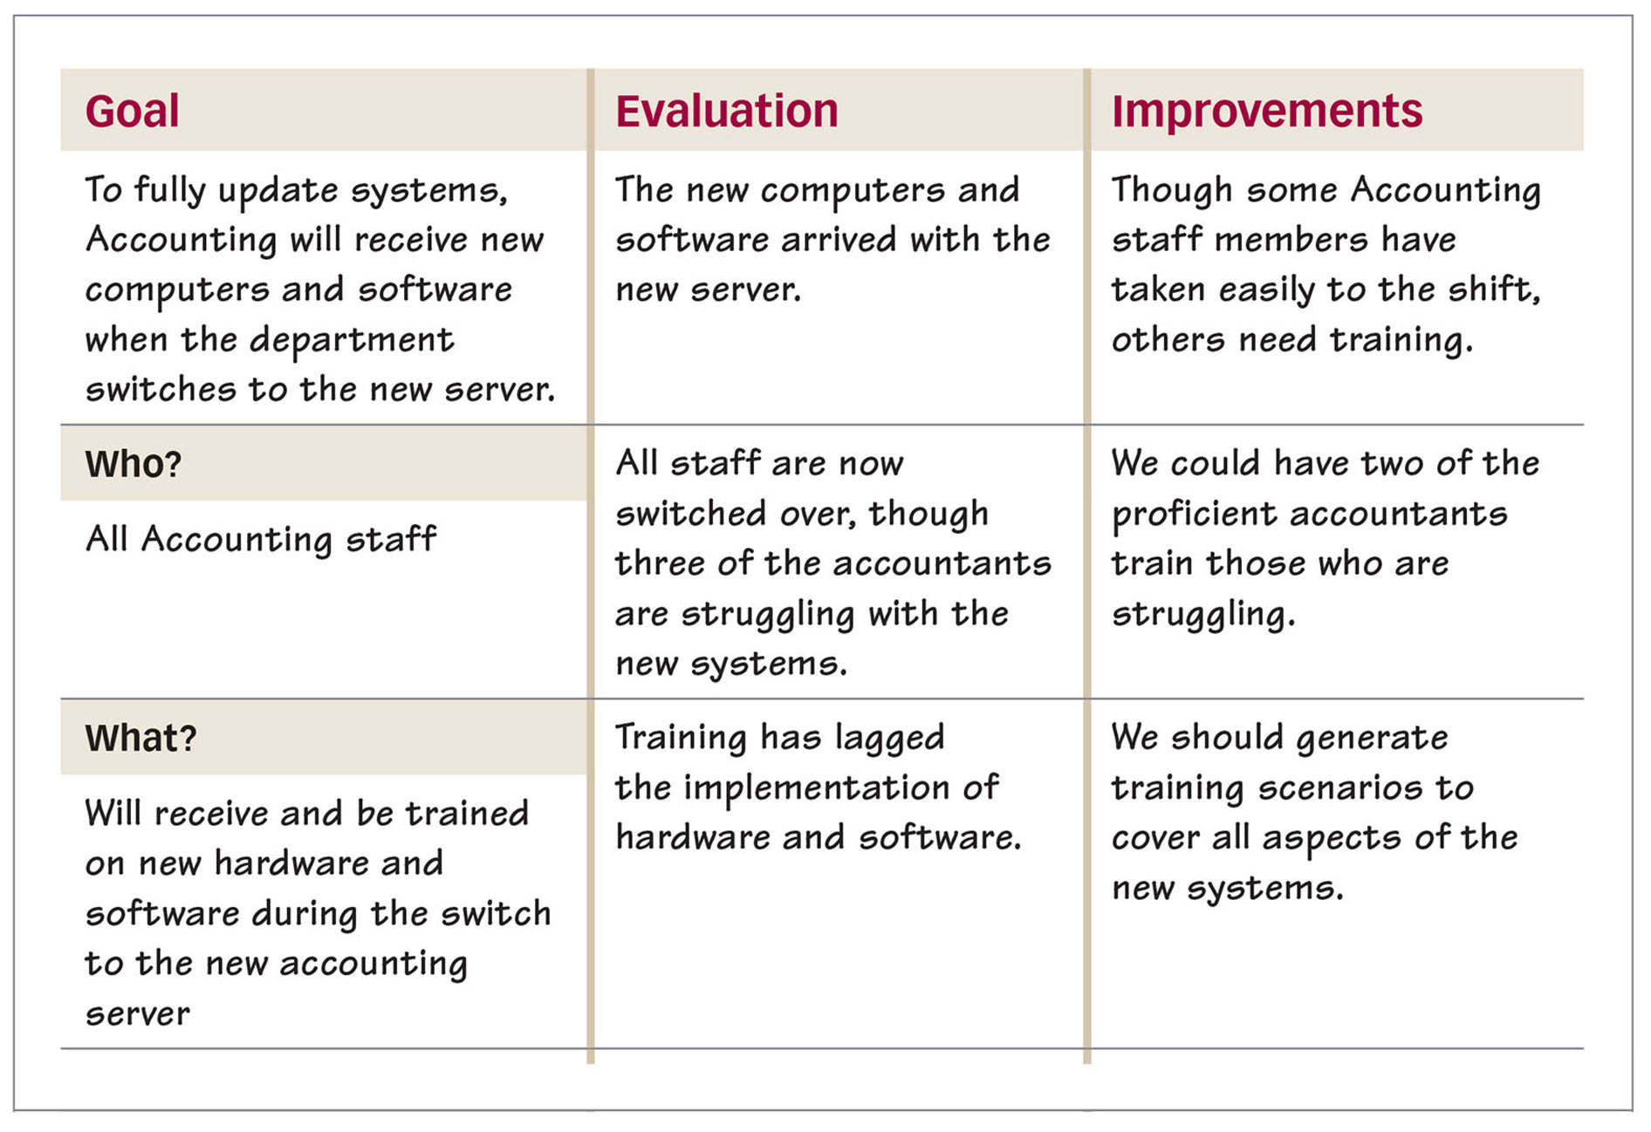
Improving Your Solution
How do I evaluate against my goal?

Slide 93
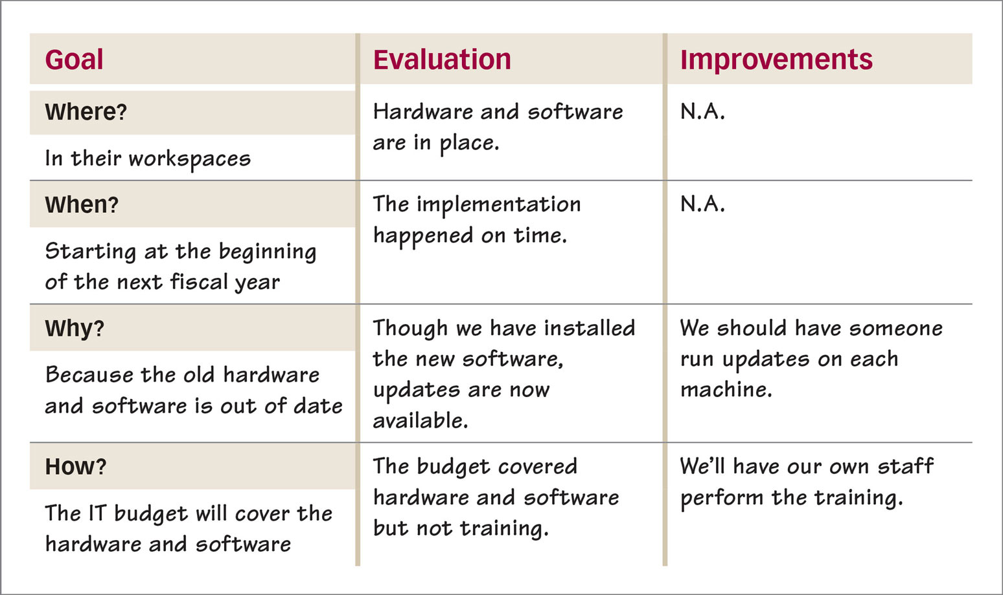
Improving Your Solution
How do I evaluate against my goal?

Slide 94
Activity 14:
Apply Ideas

Slide 95
Activity 15:
Lesson Wrap-Up

Slide 96

Lesson 3
Using Advanced Strategies
Lesson Preview
    Using the Reading Process
    Using the Writing Process
    Using Process Thinking
    Using Design Thinking
    Using the Scientific Method
    Controlling Variables
    Testing Concepts

Slide 97
My Goal
To use the reading process to gather information

Slide 98
Using the Reading Process
Imagine that you need to get a thorough grasp of a gigantic document. That’s a problem. The reading process can help you solve the problem.
What is the reading process?
The reading process is a set of steps that will help you quickly comprehend and thoroughly understand a text. The process can be summed up with the acronym SQ3R.

Slide 99
Using the Reading Process
What is the reading process?
Survey the material to get a sense of what you are about to read.
  Read all headings and note their arrangement.
  Look at each graphic (photo, table, illustration, graph) to get a sense of what’s coming.
  Skim each caption to better understand the graphics.
  Figure out how much material there is and how much time you have to get through it.

Slide 100
Using the Reading Process
What is the reading process?
Question the communication situation. Whatever you read is a message with a source, a medium, a context, and an intended audience:
  Source: Who wrote this?
  Message: What’s the main point? Why did the person write it? What does the person want the reader to do with the information?
  Medium: How is this message presented? How was it originally presented? In what way does the medium enhance or detract from the message?
  Audience: Who is supposed to read this? Are you part of the intended audience?
  Context: When was this written? What was going on then? Where was this written? How does this fit in with other things that the source created? How does this fit in now?

Slide 101
Using the Reading Process
What is the reading process?
Read the text through, focusing on each part but moving at a reasonable pace. Reread parts that are difficult or confusing. Underline important material, write notes in the margins, and write down new terms and questions you might have.

Slide 102
Using the Reading Process
What is the reading process?
Recite the key points aloud when you finish reading. Flip through the reading and, on each page, summarize the information aloud in a sentence or two. Give an overall summary at the end of the material.

Slide 103
Using the Reading Process
What is the reading process?
Review the material regularly, noting what you underlined, rereading your notes in the margins, and reciting main points aloud. By returning to the material, you signal your brain that this information needs to be stored in long-term memory rather than short-term memory.

Slide 104
Activity 16:
Use the Reading Process

Slide 105
My Goal
To use the writing process to create written solutions

Slide 106
Using the Writing Process
Imagine that you have been assigned to write a 50-page annual report that will be presented to the head of your organization. That’s a problem. The writing process offers a solution. Instead of trying to write the report all at once, you break the process into four manageable steps:
Prewriting
Drafting
Revising
Refining

Slide 107
Using the Writing Process
What is prewriting?
Prewriting is the process of analyzing the situation, finding your focus, gathering details, and organizing ideas. During prewriting, you should
identify your purpose.
consider your readers.
think about the context.
perform research.
develop a list or an outline.
choose a document format.

Slide 108
Using the Writing Process
What is drafting?
Drafting is the act of writing your message. During drafting, you should
flesh out your outline.
write an opening that focuses the document.
create a middle that provides important details.
draft a closing that indicates action or
follow-up.

Slide 109
Using the Writing Process
What is revising?
Revising is the process of fixing weaknesses in content. During revising, you should
add, cut, and clarify content.
test your ideas, organization, and voice.

Slide 110
Using the Writing Process
What is refining?
Refining is fine-tuning the document before sending it. During refining, you should
check word choice for clarity and conciseness.
edit your sentences for smoothness.
proofread for correct spelling, grammar, punctuation, and mechanics.
finalize the document’s design.

Slide 111
Activity 17:
Use the Writing Process

Slide 112
My Goal
To use process thinking to create procedures

Slide 113
Using Process Thinking
Imagine that you need to come up with a new procedure—instructions for how a certain task is to be accomplished. Process thinking can help you devise a solution.

Slide 114
Using Process Thinking
What is process thinking?
Process thinking requires you to analyze each step in a process and connect all of the steps in a chronological or cyclical flow. A recipe is one example of process thinking. Instructions for assembling a machine or for installing new software are other kinds of process thinking.

Slide 115
Using Process Thinking
What is process thinking?
Another example of process thinking is a standard operating procedure (SOP). The purpose of a SOP is to provide an organization or unit with common instructions for performing a task or procedure. Much of the U.S. Army’s daily regiment is driven by a series SOPs, focusing on topics from room cleanliness to chain of command. As you can imagine, clear process thinking is of the utmost importance in a military setting.

Slide 116
Using Process Thinking
How can I create effective instructions?
You can write clear instructions for any process by following these tips:
Introduce the process that you will describe.
List any materials or tools that the person will need.
Create a numbered list of steps in chronological order.

Slide 117
Using Process Thinking
How can I create effective instructions?
Use command verbs to start each step, telling what to do.
Choose precise language to ensure understanding.
Note any cautions or WARNINGS in the process.
Use conditionals (if . . . then) to indicate decision points.
Provide and label visuals (photos, diagrams) to aid understanding.

Slide 118
Using Process Thinking
What visual elements can I use to clarify a process?
You can use a number of visual elements to clarify a process.
Photos show was something should look like or how something is done.
Diagrams provide a detailed look at something, including its parts.
Color can signify importance. For example, you may use a red font to signal a warning or caution.
Arrows can be used to trace the flow of a process.
Symbols can be used to indicate a warning or special consideration.

Slide 119
Activity 18:
Use Process Thinking

Slide 120
My Goal
To use principals of design thinking to solve problems

Slide 121
Using Design Thinking
Imagine that you need to design a new product or service for your department. You can tackle this problem by using design thinking.

Slide 122
Using Design Thinking
What is design thinking?
Design thinking is a version of the problem-solving process that focuses on experimentation, exploration, and innovation. It features prototyping, which lets the designer fail “early and often” in order to learn from mistakes. Design thinking is the process pioneered by inventors from Thomas Edison to Steve Jobs, focusing on the end user’s experience.

Slide 123
Using Design Thinking
What are the stages of design thinking?
Design thinking involves the following stages:
Define the issue you want to address, the people who are involved, and what the success criteria will be for a solution.
Research the issue, focusing on its history, current obstacles, previous solutions, the ideas of stakeholders, and the needs of the end users.

Slide 124
Using Design Thinking
What are the stages of design thinking?
Brainstorm possible solutions, generating an excess of ideas, exploring even impossible or ridiculous notions, and turning the issue around and thinking of it from multiple perspectives.
Prototype ideas by creating inexpensive, small-scale, rapid experiments to find out what will work and what will not. (See page 24.) Create multiple versions and decide when a given prototype is ready to share with stakeholders and end users. Get feedback and buy-in. (See page 26.)

Slide 125
Using Design Thinking
What are the stages of design thinking?
Rework the prototype, responding to feedback and exploring new options. Revisit the goal and objectives of the project and make adjustments that move the prototype toward an actual version.
Implement the solution, putting it into place in a real-life situation. Monitor its performance, checking constantly against the goal and objectives for the project. Make ongoing improvements, and document your work.

Slide 126
Using Design Thinking
How do businesses use
design thinking?
Everything that has a design—from computer keyboards to shoes to cars to this very manual that you are using—has resulted from design thinking. It is the way that the business world creates innovation.

Slide 127
Activity 19:
Use Design Thinking

Slide 128
My Goal
To use scientific principles to solve problems

Slide 129
Using the Scientific Method
Imagine that you are assigned to find out why a specific system is failing or why a given product doesn’t work. Whenever you are faced with discovering the causes of a problem, you can use the scientific method.

Slide 130
Using Design Thinking
What is the scientific method?
The scientific method is a form of problem solving that focuses on causes and effects within a specific situation. You can use the scientific method to troubleshoot issues and, by process of elimination, discover the true causes. Follow these steps:

Slide 131
Using Design Thinking
What is the scientific method?
Identify a problem. Make sure that you fully understand the problem, all of the components, the people involved, and what the desired resolution is.
List variables. Think of all of the possible causes of the problem. Write them down.

Slide 132
Using Design Thinking
What is the scientific method?
Create a hypothesis that predicts the outcome when you test the situation by manipulating variables.
Control all variables but one. Create a situation in which all of the possible causes are ruled out except the one you are testing.

Slide 133
Using Design Thinking
What is the scientific method?
Observe outcomes and record data. Does changing the one factor change the outcome? If not, what other factor or set of factors is most likely to be the true cause?
Conclude whether the experiment supported the hypothesis. If so, you have your solution. If not, you can create a new hypothesis, selecting a new variable to test.

Slide 134
Using Design Thinking
How can I identify a problem and list variables?
Usually, problems identify themselves: Something fails. It might be a product, service, plan, machine, or even relationship.
Problem
Every Thursday afternoon, Internet access runs slowly.

Slide 135
Using Design Thinking
How can I identify a problem and list variables?
After you’ve identified the problem, you should list the possible causes for the problem.
Possible Causes
Are there more users on the broadband?
Is the problem with our service?
Are other businesses on the block taxing the system?
Is there a program that runs in the background on Thursdays?
Do the network computers have a virus?

Slide 136
Using Design Thinking
How can I identify a problem and list variables?
Once you have listed variables, you can check each variable to see if it is the cause. Pages 46-47 will show you how.

Slide 137
Activity 20:
Use the Scientific Method

Slide 138
My Goal
To choose one potential cause to test, to control the other causes, and to create a hypothesis

Slide 139
Controlling Variables
After you have identified the possible causes of the problem, you need to choose one possible cause that you want to test for and create a hypothesis about it.

Slide 140
Controlling Variables
How can I create a hypothesis?
Start by identifying the cause that you want to test for.
Problem
Every Thursday afternoon, Internet access runs slowly.
Possible Cause
Is there a program that runs in the background on Thursdays?

Slide 141
Controlling Variables
How can I create a hypothesis?
Then you create a prediction that connects the possible cause to the problem. This is your hypothesis. State your hypothesis as a fact (to be tested).
Hypothesis
One or more programs running in the background are causing the Internet slowdown every Thursday afternoon.
Next, you will need to figure out how to control the other possible causes (variables) so that you can test your hypothesis.

Slide 142
Controlling Variables
How can I control variables?
Start by identifying the variables that you want to control:
Variables to Control
Are there more users on the broadband?
Is the problem with our service?
Are other businesses on the block taxing the system?
Do the network computers have a virus?

Slide 143
Controlling Variables
How can I control variables?
Then figure out how to rule out or control all of these variables:
Controlling Variables
I need to test the system with an average number of users running typical programs.
I need to call our Internet service provider to make sure there isn’t a general slowdown in service.
I need to ask our Internet service provider about use rates in our neighborhood.
I need to run virus scans on all computers before testing.

Slide 144
Activity 21:
Control Variables

Slide 145
My Goal
To use the scientific method to test different variables

Slide 146
Testing Concepts
So, you’ve identified a problem, listed possible causes, selected one to test, created a hypothesis about it, and thought of ways to control the other variables (possible causes) in the situation. You have all the pieces of experimental design in place.

Slide 147
Testing Concepts
How can I design an experiment?
List your problem and hypothesis. Then outline the method you will use to test the hypothesis:
Problem
Every Thursday afternoon, Internet access runs slowly.
Hypothesis
One or more programs running in the background are causing the Internet slowdown every Thursday afternoon.

Slide 148
Testing Concepts
How can I design an experiment?
Method
I will measure the average times for the following actions on Monday, Tuesday, Wednesday, and Thursday afternoons:
Home-page launch time
Page-refresh time
PDF-download time
FTP-upload time
After recording these baselines, I will ask the IT department to suspend any programs running in the background and test the rates again. If background programs are causing the slowdown, the rates when they are shut down should match the average rates on afternoons other than Thursday.

Slide 149
Testing Concepts
How can I design an experiment?
Controlled Variables
I will make sure all computers are virus free, that the number of users is consistent each day at the time of measurement, that the types of Internet usage are analogous, and that no problems exist with the Internet service provider or the neighborhood network.

Slide 150
Testing Concepts
How should I record data?
Make measurements according to your experimental design and write them down. If you have many measurements, record them in a spreadsheet so that you can easily search them for patterns. If possible, output different columns and rows of your spreadsheet as graphics (bar graphs, line graphs, pie graphs, and so on) to help you recognize patterns.

Slide 151
Testing Concepts
How can I draw conclusions?
First, check to see whether your prediction matched the outcome of the experiment. If it did, your hypothesis has been supported. If not, consider whether the hypothesis should be rejected. Whatever the outcome, think about whether any flaws in experiment design skewed the results in either direction.

Slide 152
Activity 22:
Test Concepts

Slide 153
Activity 23:
Lesson Wrap-Up

Slide 154
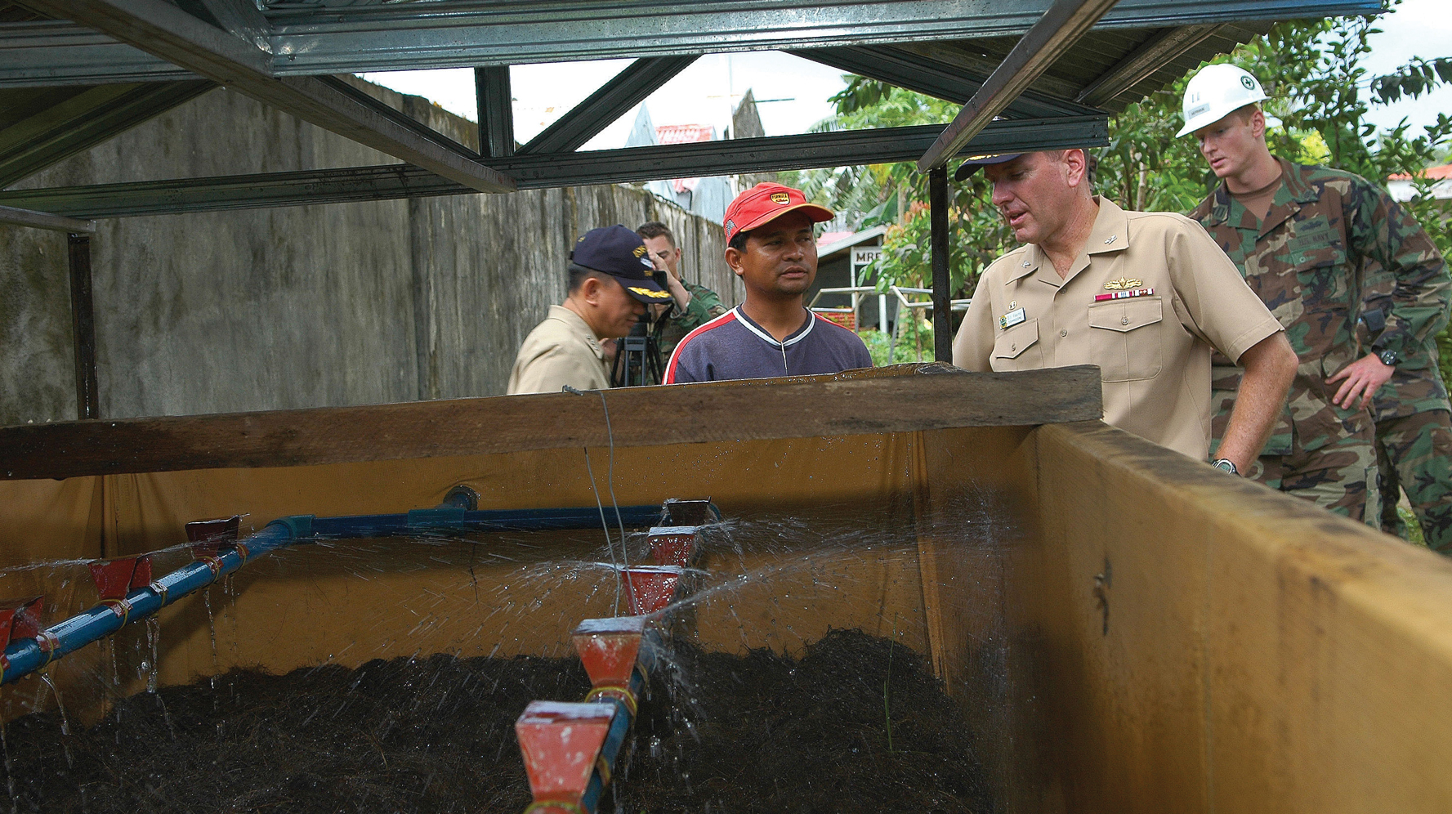
Lesson 4
Team Problem Solving
Lesson Preview
    Collaborating
    Group Brainstorming
    Resolving Conflicts
    Making Decisions
    Communicating in Meetings
    Applying Your Learning
    Taking a Post-Assessment

Slide 155
My Goal
To learn strategies for getting groups of people to work efficiently together toward a common goal

Slide 156
Collaborating
In the workplace, problem solving often involves collaboration. The word “collaborate” means literally “work together.”

Slide 157
Collaborating
How can we get people to work together?
For any group to collaborate effectively, members must respect and trust each other as well as share common goals.

Slide 158
Collaborating
How can I get people to work together?
Respect creates an atmosphere in which all group members can contribute. Without respect, the group will disintegrate before it can even get started. But respect alone is not enough to ensure true collaboration.

Slide 159
Collaborating
How can I get people to work together?
Trust is the confidence that other group members will do the tasks they have agreed to do, on time and in a way that benefits the whole effort. Without trust, some group members will try to do everything, while others will feel excluded. Trust makes true collaboration possible.

Slide 160
Collaborating
How can I get people to work together?
Goal setting establishes the direction the group is taking. Without a common goal, the group’s effort will be fragmented or even self-destructive. Once group members respect each other, trust each other, and have common goals, barriers to achievement drop away.

Slide 161
Collaborating
How can we set goals?
You can have the group work together to fill out a planning sheet. Even if you don’t physically have the planning sheet in a meeting, you’ll want to ask the same questions:

Slide 162
Collaborating
How can we set goals?
What is our overall goal?
Who will be involved?
What are we trying to do?
Where will we pursue this goal?
When should we start and finish?
Why are we doing this?
How will we get it done?

Slide 163
Collaborating
How can we delegate?
Delegation is key to collaboration. If one person does all the work, the power of the team is lost. Once again, you can use your planning sheet to structure the task of delegating. Follow these steps:

Slide 164
Collaborating
How can we delegate?
List the tasks that need to be accomplished.
Assign a time frame for each task.
Assign one person or more people to do each task in the time frame.
List tools (equipment, materials, information, resources) available to team members.
Monitor progress, checking against your plan.

Slide 165
Activity 24:
Collaborate

Slide 166
My Goal
To use group brainstorming to discover solutions to problems

Slide 167
Group Brainstorming
Just as you can work by yourself to brainstorm solutions (see pages 12-13), you can also brainstorm in a group setting.
What is group brainstorming?
Group brainstorming involves a team of people rapidly coming up with as many possible solutions and possibilities as they can. The process should include these three steps:

Slide 168
Group Brainstorming
What is group brainstorming?
Collect ideas in a list or a mind map. Record the ideas quickly as they are offered.
Delete any doubles. Sort through the ideas and compose a revised list of the best ideas.
Evaluate the revised list. Identify the especially strong ideas and catalog them for future use.

Slide 169
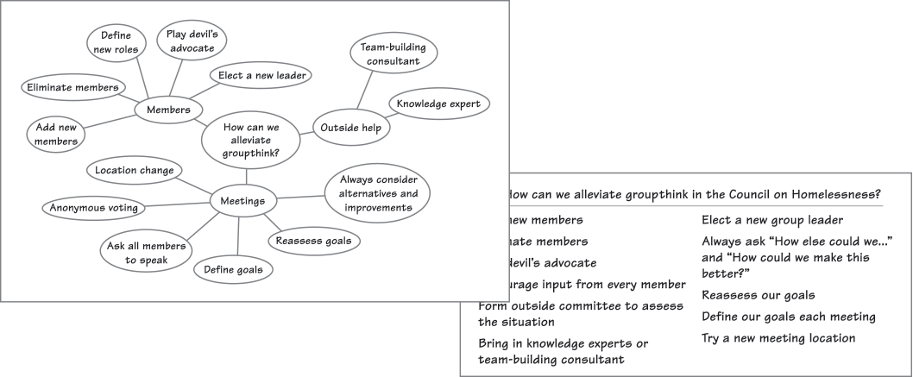
Group Brainstorming
What is group brainstorming?

Slide 170
Group Brainstorming
How can I set rules for group brainstorming?
The advantage of group brainstorming is that it brings together many diverse minds with unique ideas. However, group brainstorming can veer off course if not managed properly. Group brainstorms work best when group members follow certain rules.

Slide 171
Group Brainstorming
How can I set rules for group brainstorming?
Choose a moderator. The moderator’s job is to make sure everyone follows the rules and keeps the brainstorming on task. Though the moderator can contribute to the session, the person’s role is not to dominate the conversation.
Disallow criticism. Group members should listen and accept all ideas. Criticism creates a chilling effect on creativity, especially for the target of the criticism.

Slide 172
Group Brainstorming
How can I set rules for group brainstorming?
Encourage creative, off-the-wall ideas. Some of the best solutions spawn from the wildest ideas. Record all ideas without judgment.
Strive for quantity. The more ideas, the better. Group members should not be concerned with coming up with the best or perfect solution, just whatever comes to mind.
Connect and expand each others' ideas. Group brainstorms are most effective when all members feel secure enough to share, rework, and expand each others' ideas.

Slide 173
Activity 25:
Brainstorm Solutions
with a Group

Slide 174
My Goal
To understand the options for resolving conflicts

Slide 175
Resolving Conflicts
To resolve conflicts in a team, you need to manage your emotions, define the conflict, and use a resolution strategy.
How can I manage my emotions?
If you find yourself in a conflict with a group member, you should first get a handle on your emotions. Follow this four-step process:

Slide 176
Resolving Conflicts
How can I manage my emotions?
Identify the emotion you are feeling: You might be happy, sad, fearful, angry, hopeful, regretful, desiring, dreading. . . .
Identify the cause of the emotion: Emotion usually relates to you or to people, objects, or ideas that are important to you.
Note whether the emotion is appropriate in type and scale: Does the emotion fit the situation? Is it an underreaction, an appropriate reaction, or an overreaction?

Slide 177
Resolving Conflicts
How can I manage my emotions?
Decide how to manage the emotion. Here are some options:
  Express the emotion but set it aside to think critically.
  “I’m feeling very nervous about that idea, but let’s explore it.”
  Modulate the emotion to better match the situation.
  “I overreacted, but I do feel this issue is important.”
  Use the emotion constructively to engage the task.
  “I’m determined to get this problem solved.”
  Allow your emotion to connect you with others.
  “I can hear the anger in your tone, and I understand it’s because you feel passionate.”
  Recognize that emotion will play a part in decision making.
  “In the end, I have to be happy with the result, and I’m currently not happy with it.”

Slide 178
Resolving Conflicts
How can I define a conflict?
Analyze the situation by asking four questions:
What is the problem?
What is my purpose in the situation?
Who are the people involved?
Where is the conflict taking place?

Slide 179
Resolving Conflicts
How can I resolve conflicts?
You have options for resolving conflicts. Different situations call for different resolutions.
Cooperate with the other person, working for the common good.
Compromise with the other, each giving up something to meet in the middle.

Slide 180
Resolving Conflicts
How can I resolve conflicts?
Defer to the other if you do not have authority, are wrong, or consider the issue not worth fighting over.
Assert your position if you have authority, know you are right, or find alternatives unacceptable (but avoid insubordination).
Compete with the other, each trying a different approach to see which works (but avoid insubordination).

Slide 181
Activity 26:
Resolve Conflicts

Slide 182
My Goal
To understand how to make group decisions

Slide 183
Making Decisions
Successful groups decide up front how decisions will be made. Knowing who has the authority to make decisions helps everyone understand his or her individual role in the process.

Slide 184
Making Decisions
What methods of decision making are there?
The most common decision-making approaches are explained below. As you will see, each approach comes with inherent strengths and weaknesses.

Slide 185
Making Decisions
What methods of decision making are there?
Method of Deciding | Pros | Cons
Authority Rule: The group discusses issues and may make recommendations. However, one authority figure—a leader or an invited expert—makes the decision. | This method is efficient. | Members may feel they don’t get a say.
Minority Rule: A vocal or powerful minority makes a decision that the majority may disagree with but feel forced to accept. | Even minority interests can be heard and have power. | This method may leave the majority feeling left out.

Slide 186
Making Decisions
What methods of decision making are there?
Method of Deciding | Pros | Cons
Majority Rule: The group votes, and whatever option crosses a threshold of votes wins. | This approach is fair but still efficient. | Those in the minority may feel reluctant to cooperate.
Consensus Rule: All group members agree to support a solution even though some may have reservations. | Group members feel included and valued. | This method may take time and discussion.

Slide 187
Making Decisions
How can I facilitate decision making?
Follow these tips:
Know the decision-making style of the group and what your position is within the group.
Remember the five conflict-resolution strategies: assert, defer, cooperate, compromise, and compete.
Help the group state a common goal, which puts the group on the path to cooperation.

Slide 188
Making Decisions
How can I facilitate decision making?
Recognize and stop mechanical thinking—your own and others’.
Recognize and manage emotional thinking—your own and others’.
Recognize your role in the group, and carry it out successfully.

Slide 189
Activity 27:
Make Group Decisions

Slide 190
My Goal
To learn strategies for effective and efficient group communication

Slide 191
Communicating in Meetings
Groups can achieve maximum problem-solving efficiency through clear communication before, during, and after group meetings.

Slide 192
Communicating in Meetings
What communication precedes a meeting?
The person who arranges a meeting should inform each group member about the meeting’s purpose and goals as well as the following:

Slide 193
Communicating in Meetings
What communication precedes a meeting?
Who will attend
What will be discussed (See “Creating an Agenda” in the side bar.)
Where the meeting will take place
When the meeting will take place
Why the meeting is occurring (what needs to be accomplished)

Slide 194
Communicating in Meetings
What communication occurs in a meeting?
Group meetings function more efficiently when they follow a structured agenda. A full discussion of each item should take place before moving on to the next. Item discussion involves four steps.

Slide 195
Communicating in Meetings
What communication occurs in a meeting?
Introduce the topic. Provide an overview of the item.
Share new information about it. Use handouts, visuals, or a Web presentation.
Discuss the information. Enable the group members to ask questions and give opinions.
End the discussion. Close discussion when group members understand the information.
Note: Record key discussions and actions in the meeting’s minutes.

Slide 196
Communicating in Meetings
How should I communicate during meetings?
You can actively engage in a group discussion by doing the following:
Speaking: Share information, give feedback, ask questions, and clarify information.
Listening: Listen intently and think critically about what is said and—often more importantly—what is not said.

Slide 197
Communicating in Meetings
How should I communicate during meetings?
Writing: Record notes about key information. Write down questions you would like to ask the speaker or the group in general.
Reading: Follow the agenda and closely read any handouts that accompany items in discussion.

Slide 198
Communicating in Meetings
What communication occurs after a meeting?
After the meeting: (1) Archive the meeting minutes electronically so that they may be reviewed. (2) Distribute information about decisions and action items from the meeting to group members and other relevant parties.

Slide 199
Activity 28:
Communicate as a Group

Slide 200
My Goal
To create a personal contract for applying what I have learned and continuing to improve

Slide 201
Applying Your Learning
You’ve worked hard and learned a lot, but now you need to apply your learning back on the job. By creating a personal contract, you will gain the most from this course.

Slide 202
Applying Your Learning
How can I create a personal contract?
You can create a personal contract by setting a few goals and outlining specifically what you will do to reach them. Here is a sample personal contract.

Slide 203
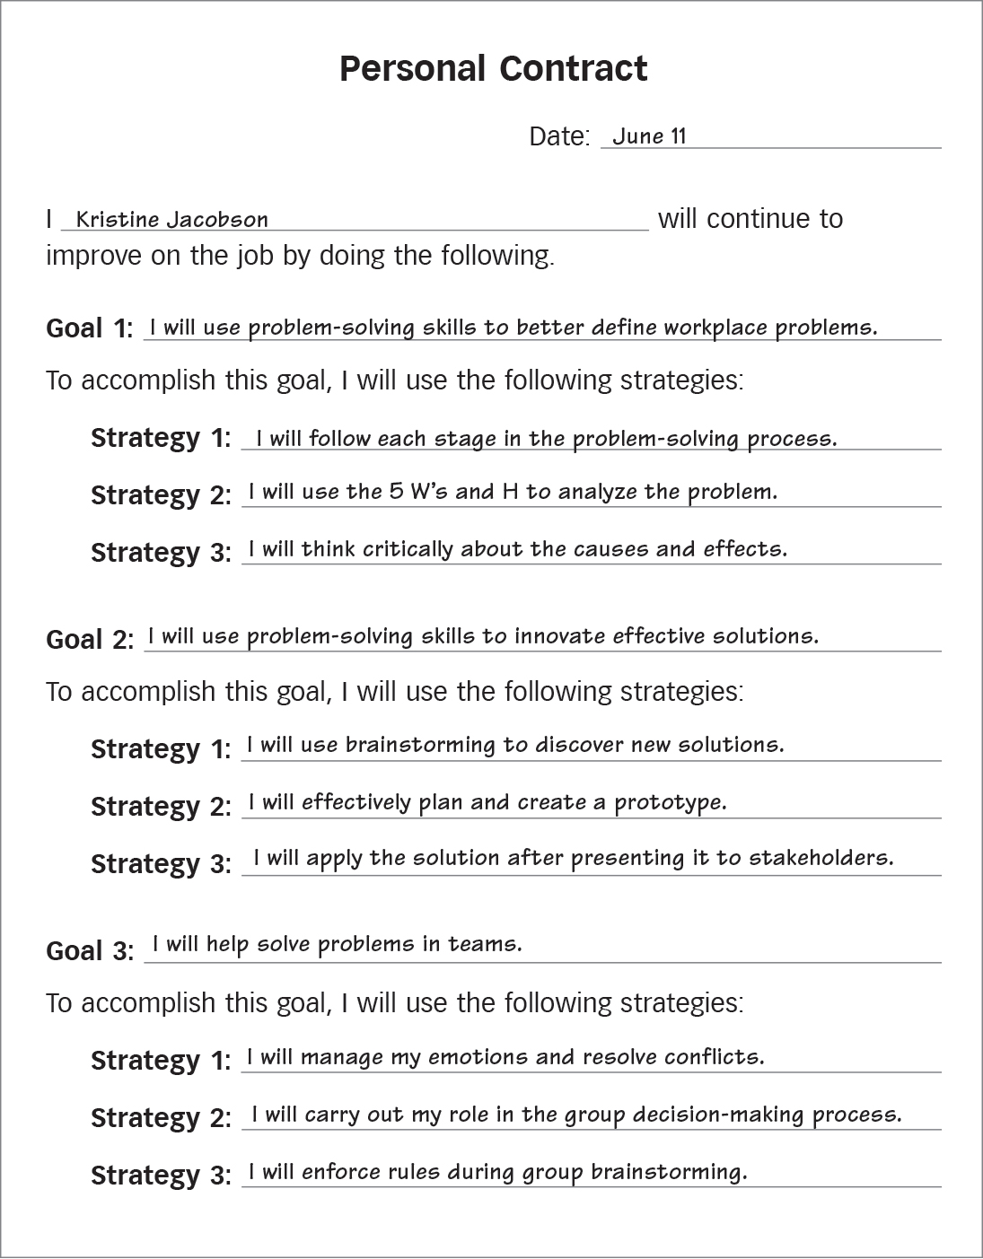
Applying Your Learning
Personal
Contract

Slide 204
Activity 29:
Create a Contract

Slide 205
Activity 30:
Taking a Post-Assessment

